Slide 1


Weather in Saudi Arabia
Data Miners Group
Raheed Albaloud (Leader)
Razan Albishri
Bashayer Alahmari
Suha Shafi
Ibrahim Alsufyani

Slide 2
TABLE OF CONTENTS
·01·
Dataset choice
·02·
Cleaning
·03·
Performing EDA
What is the Domain of our Dataset?
Reshaping And Cleaning The Dataset
Plots
·04·
Machine Learning
·06·
Pipelines
·05·
Hyperparameter Tuning
Implementation of pipelines
Splitting, feature, models
Proper hyperparameters tuning

Slide 3
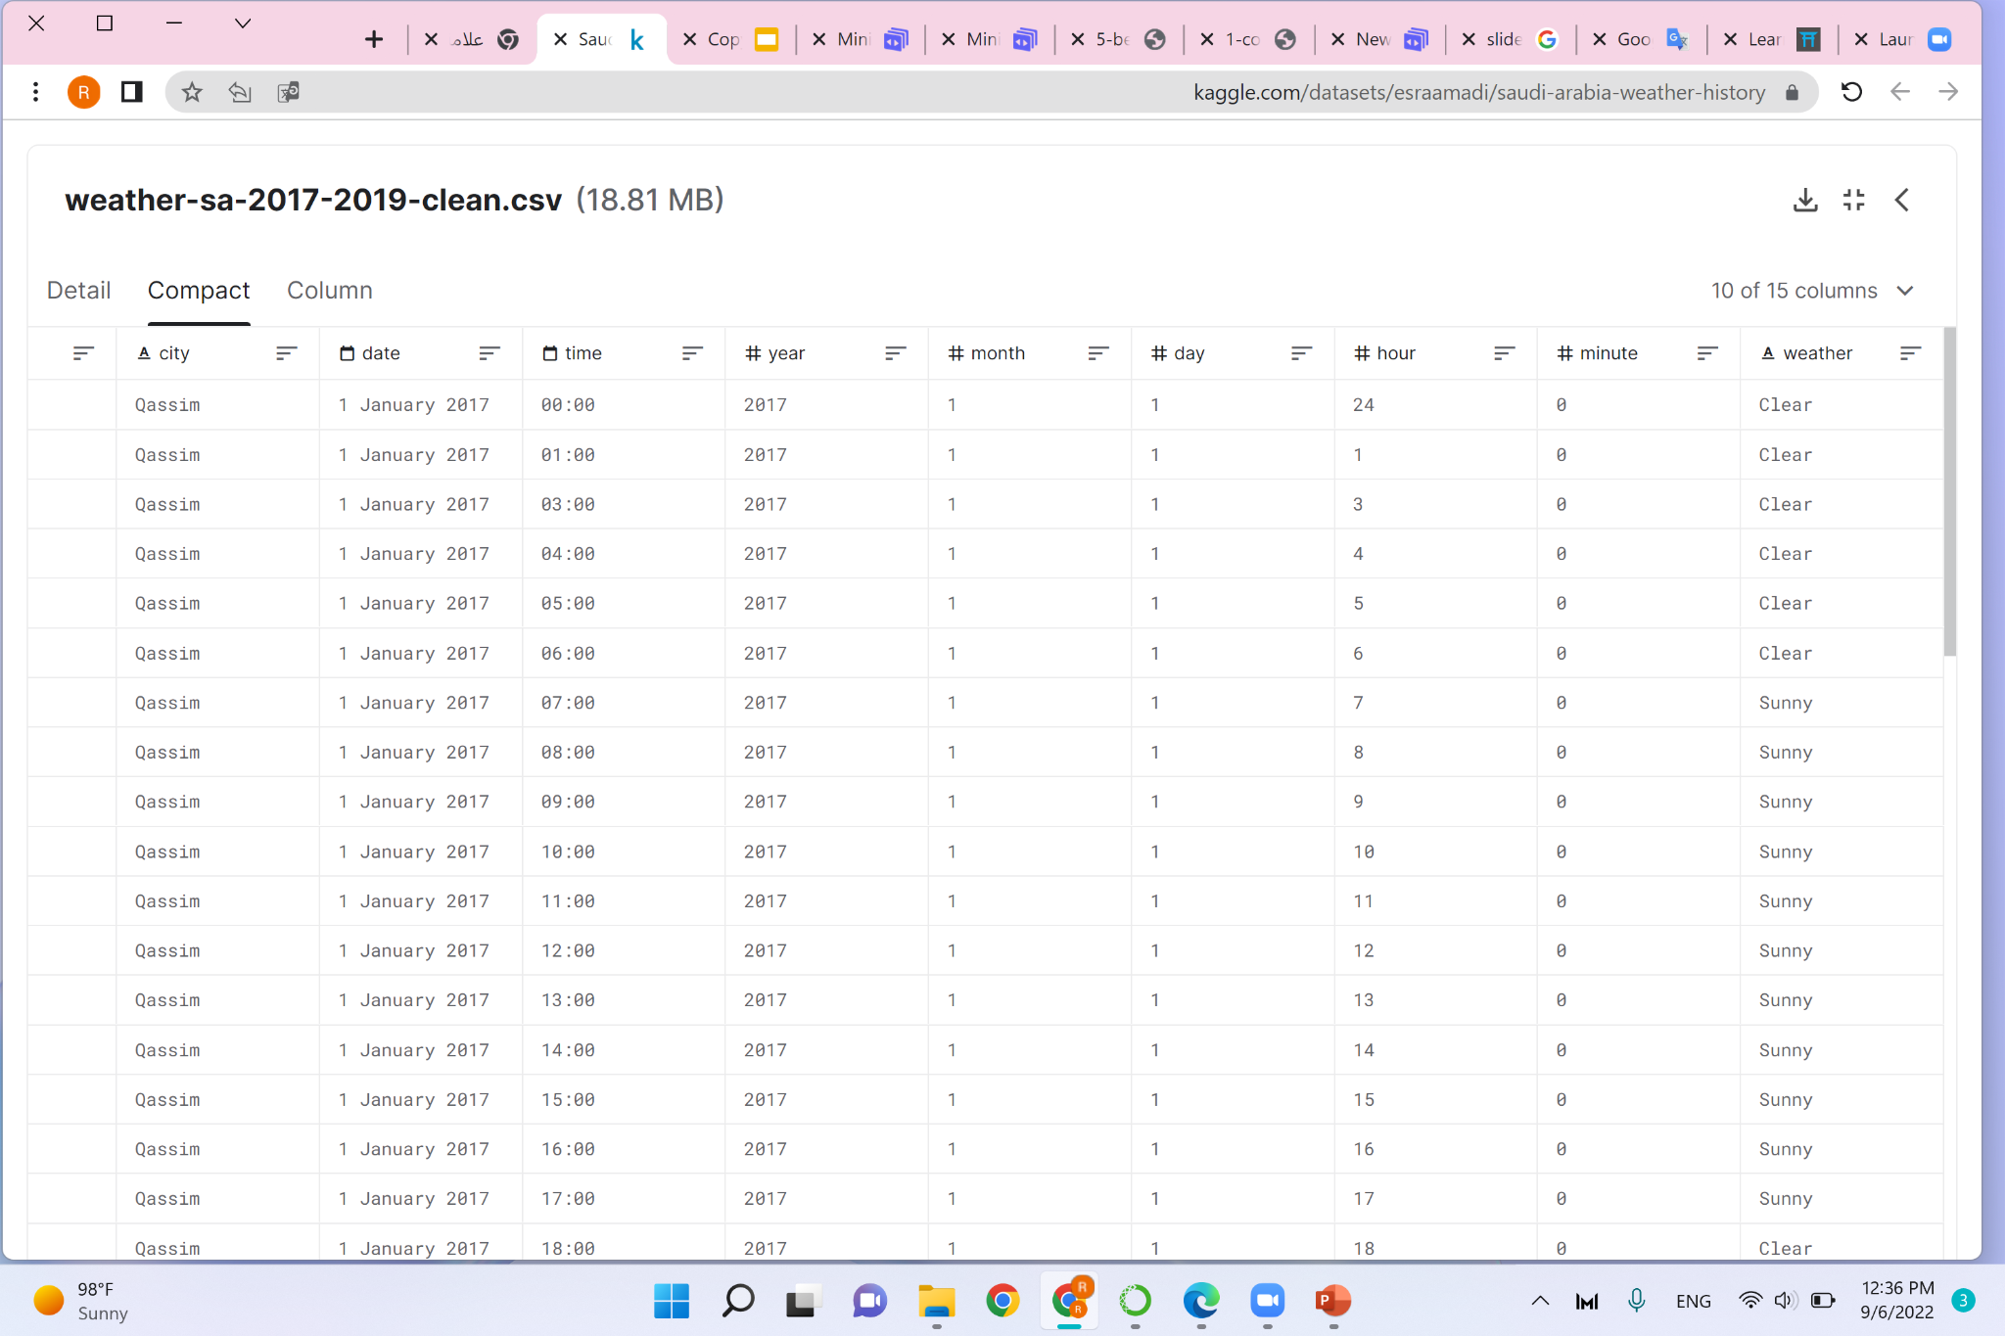
Saudi Arabia Weather Dataset

Slide 4
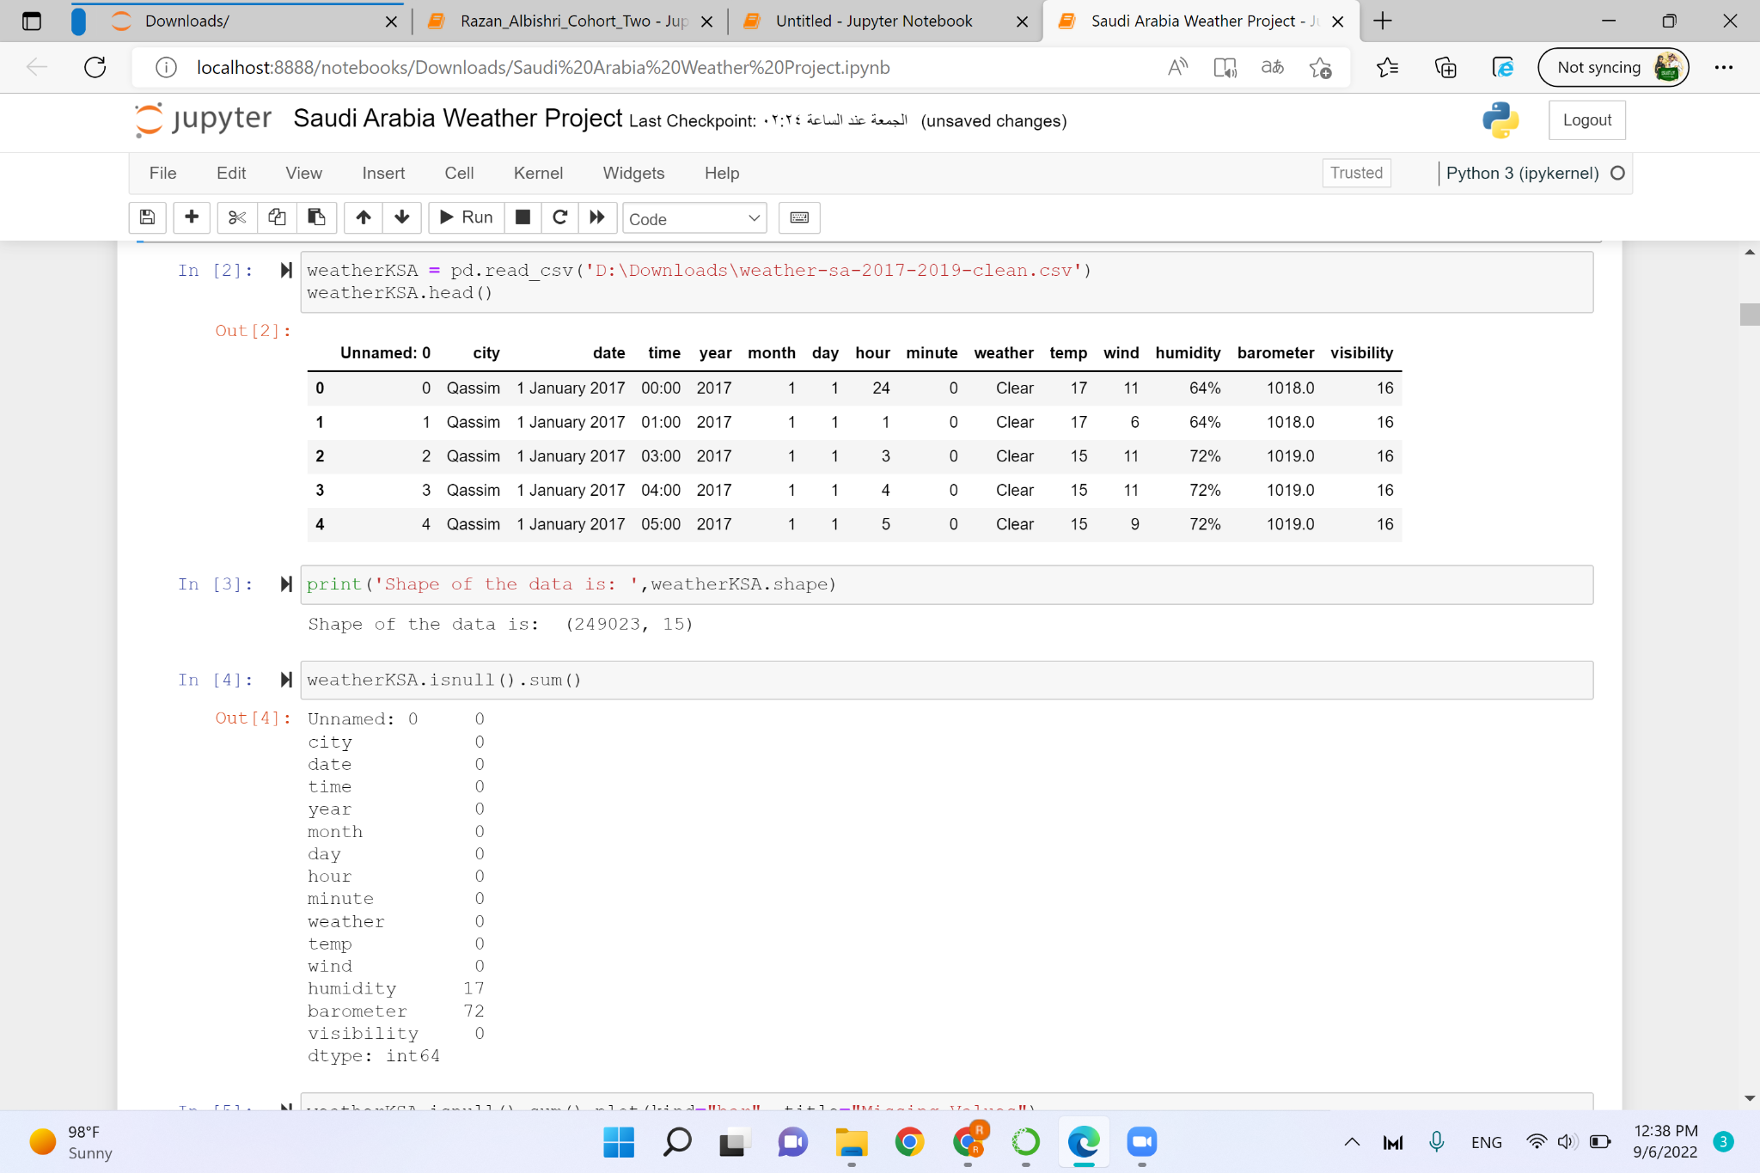
Load the dataset

Slide 5
Reshape and Clean The Dataset

Slide 6
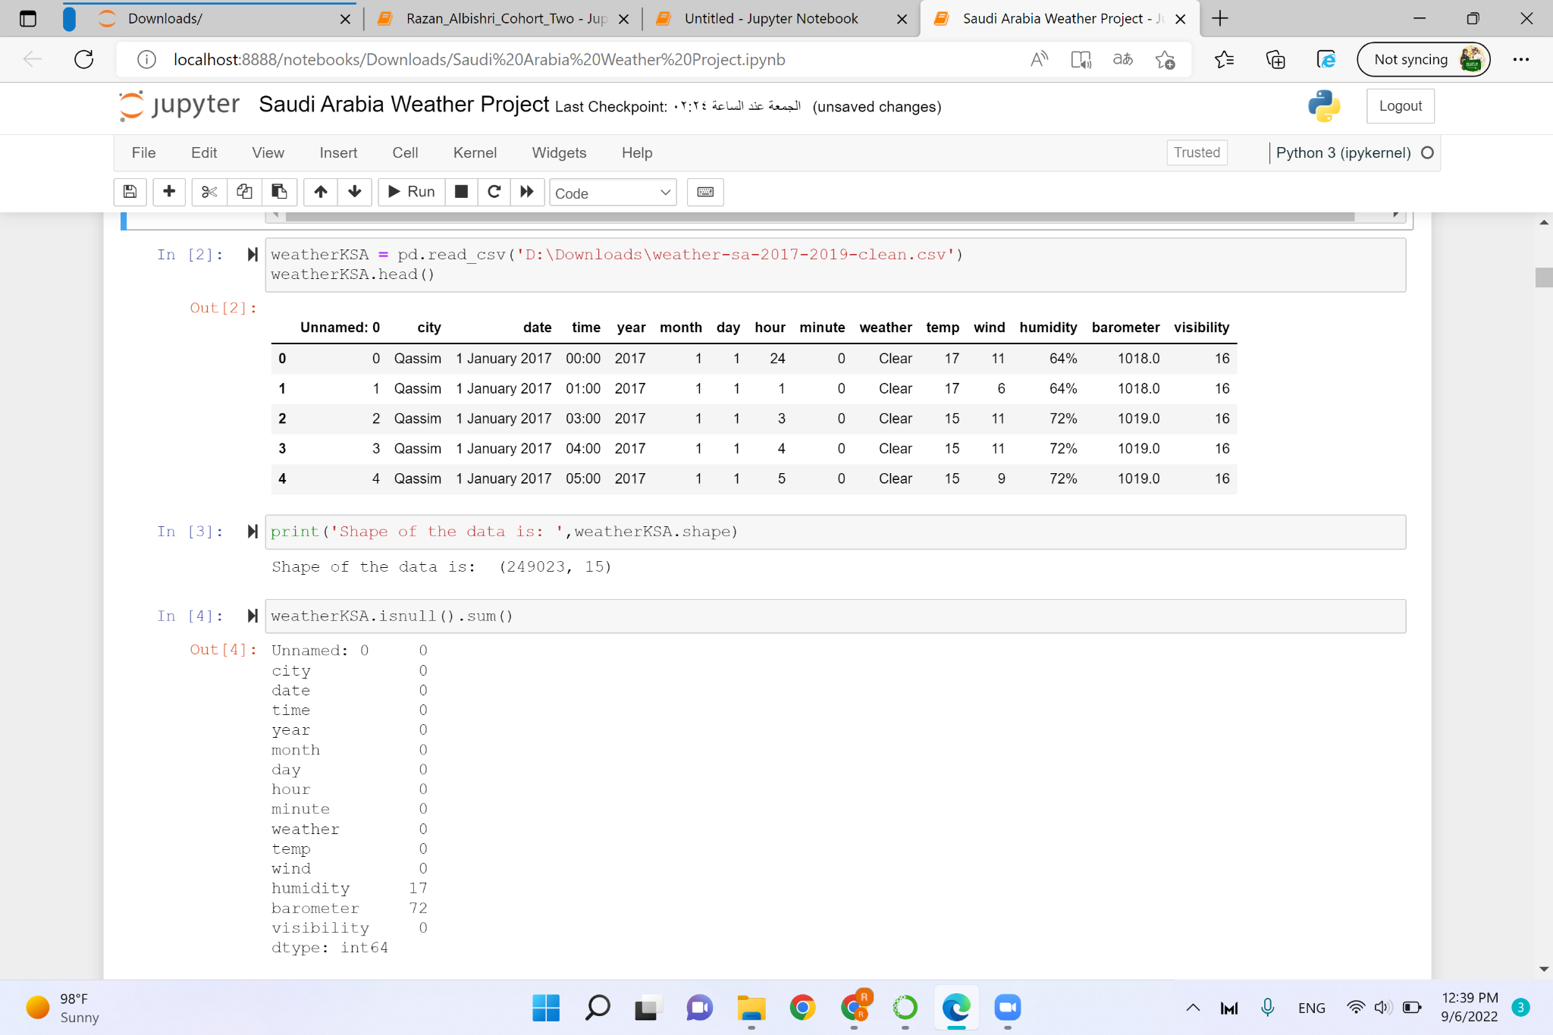
Shape of the Dataset

Slide 7
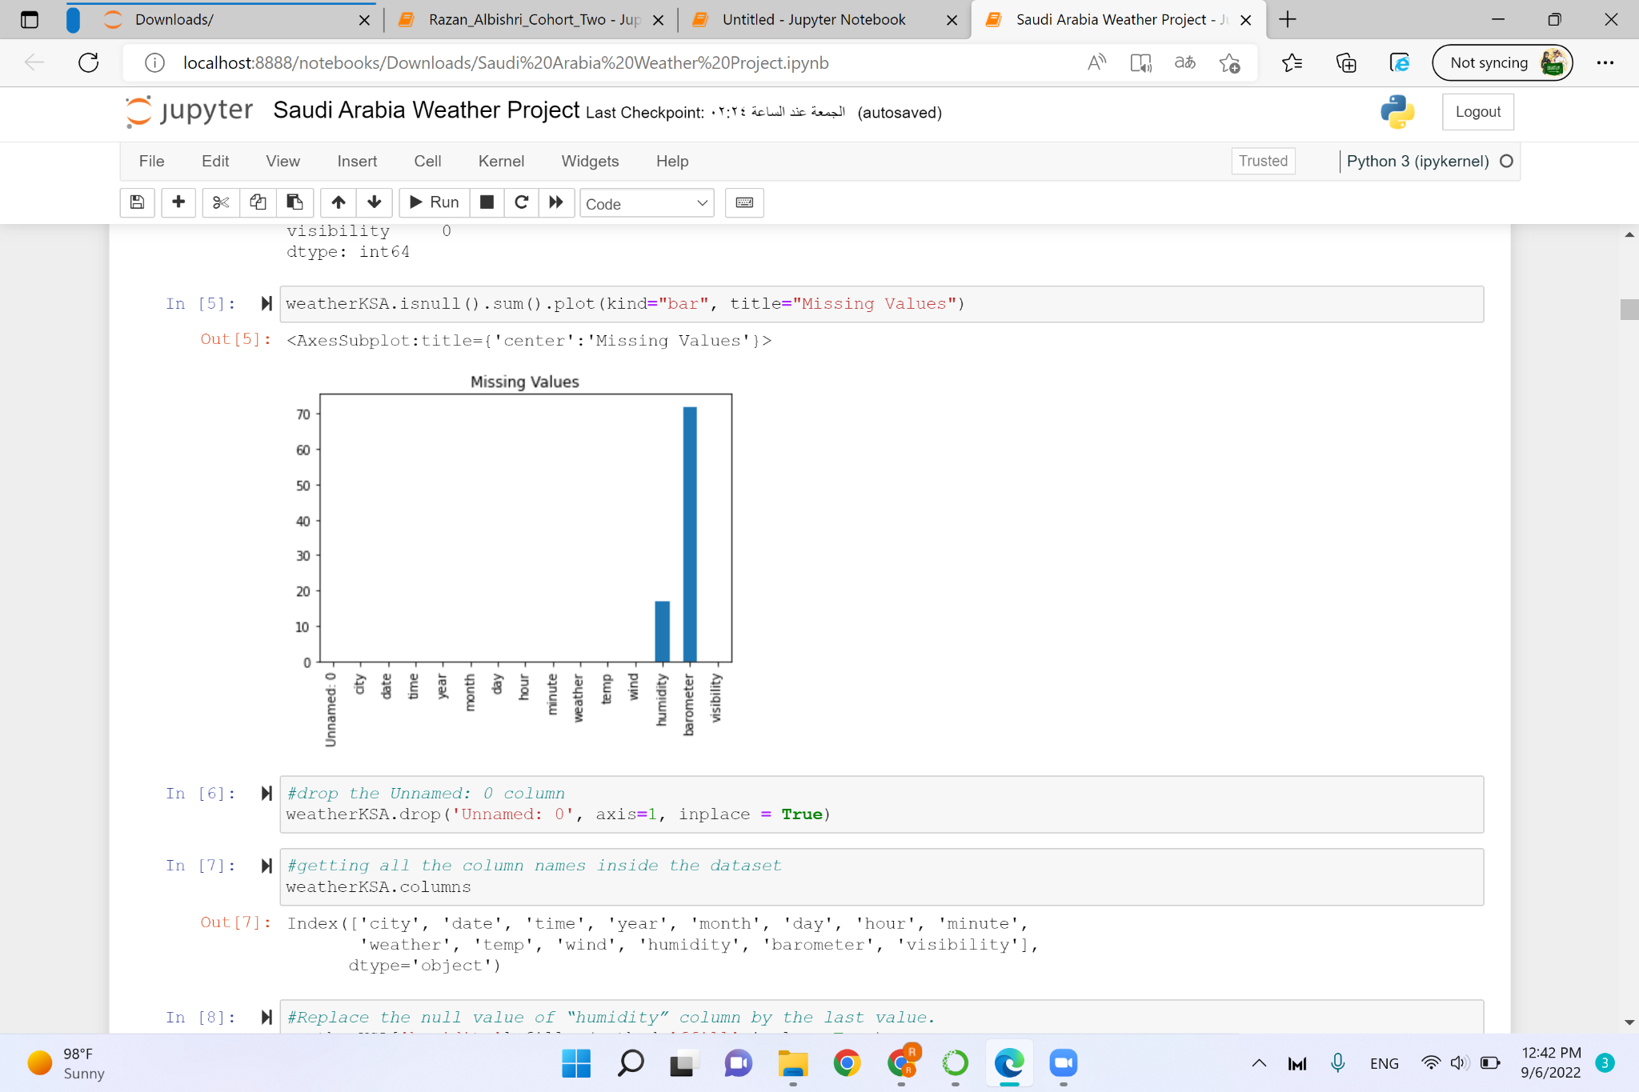
Check if there are missing values

Slide 8
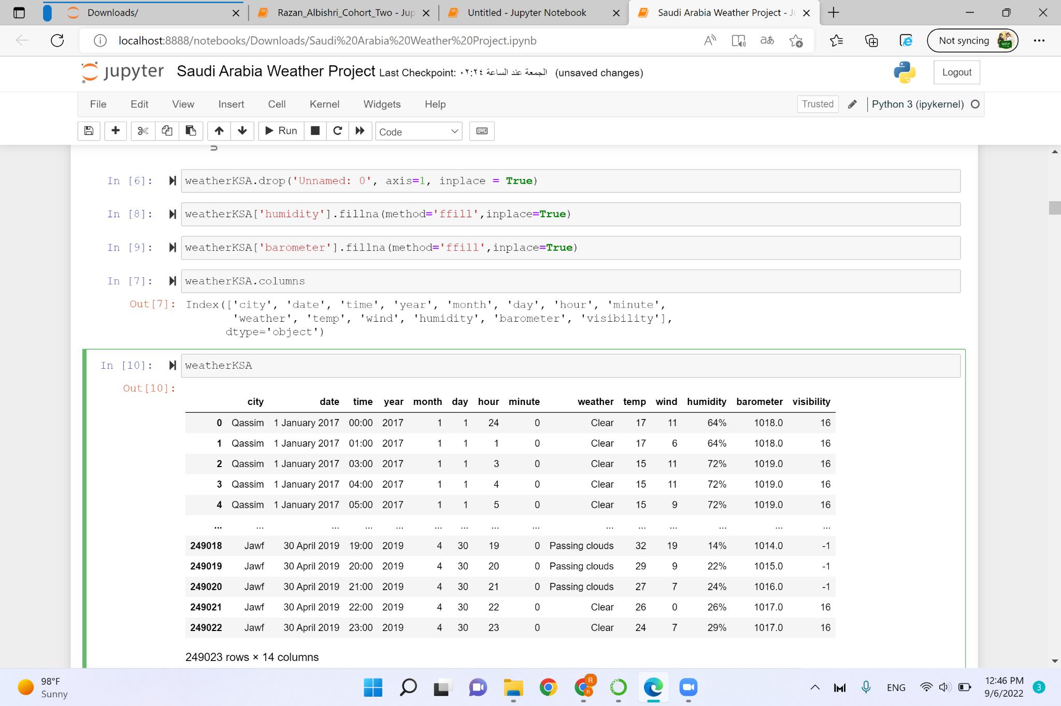
Drop and Replacement the NA values

Slide 9
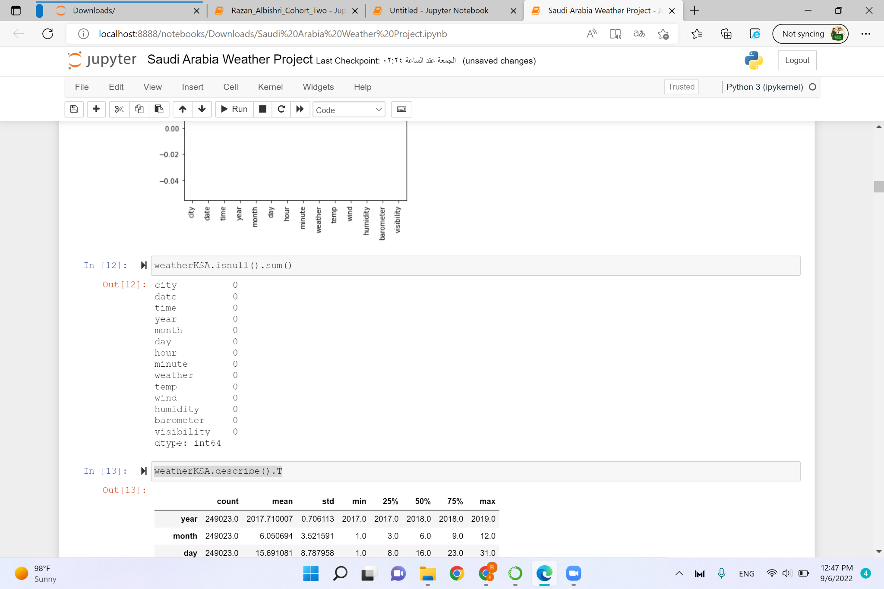
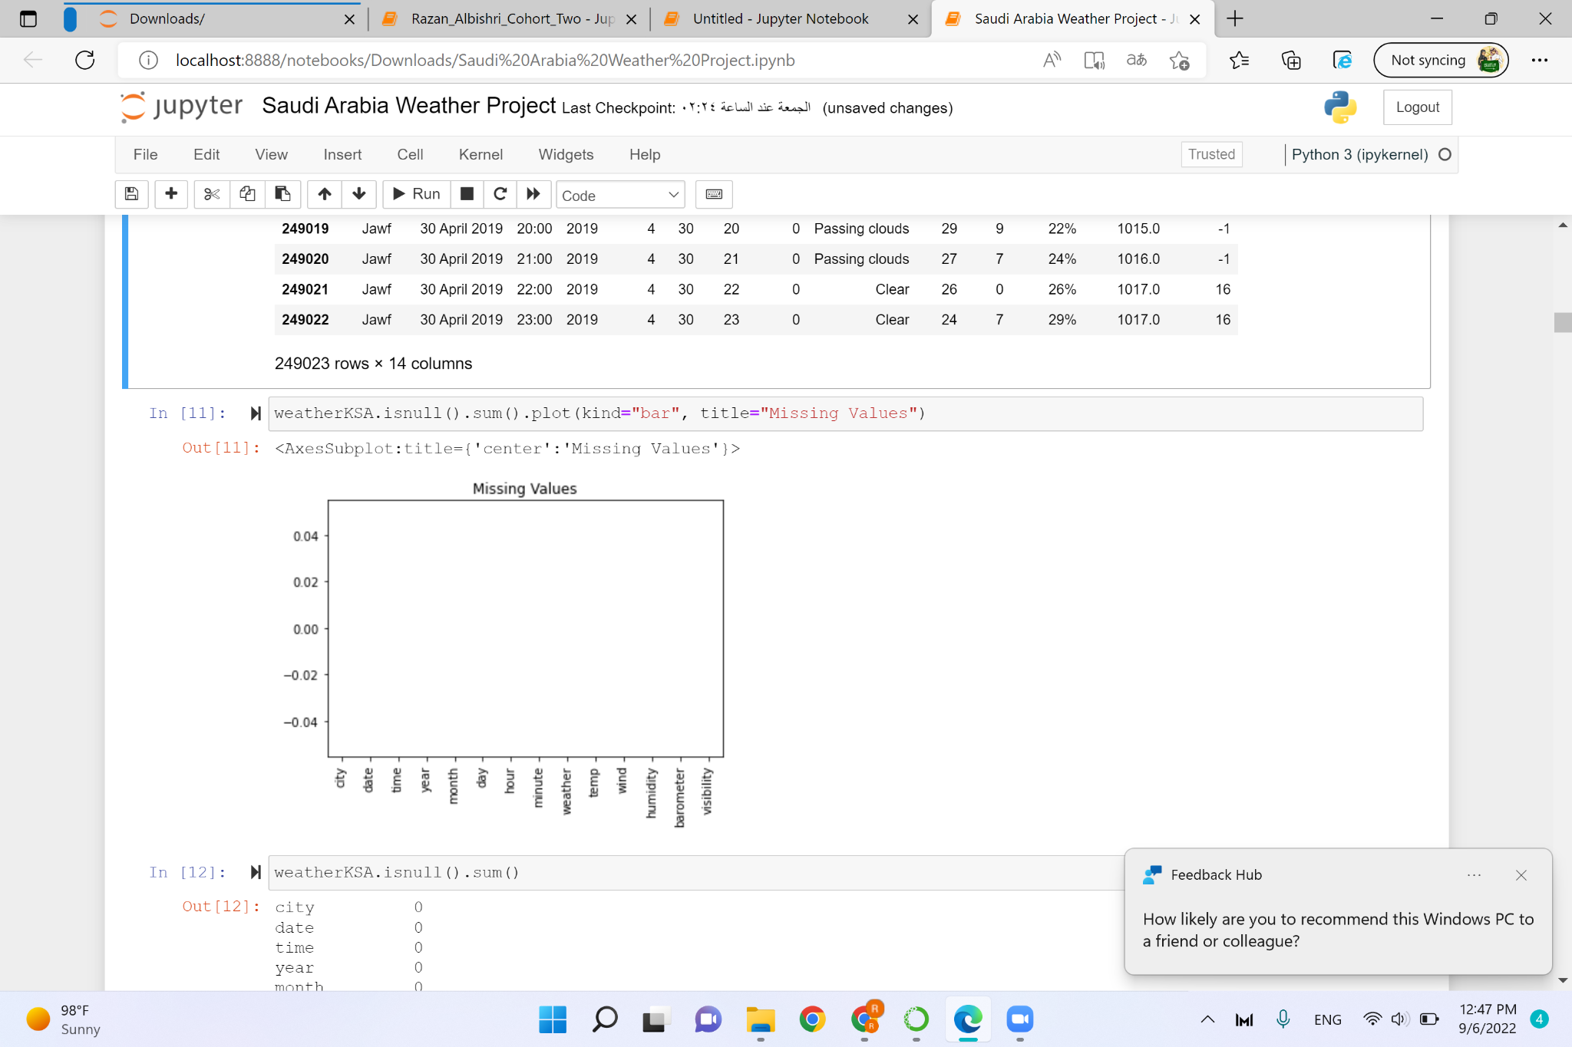
Check if there are missing values

Slide 10
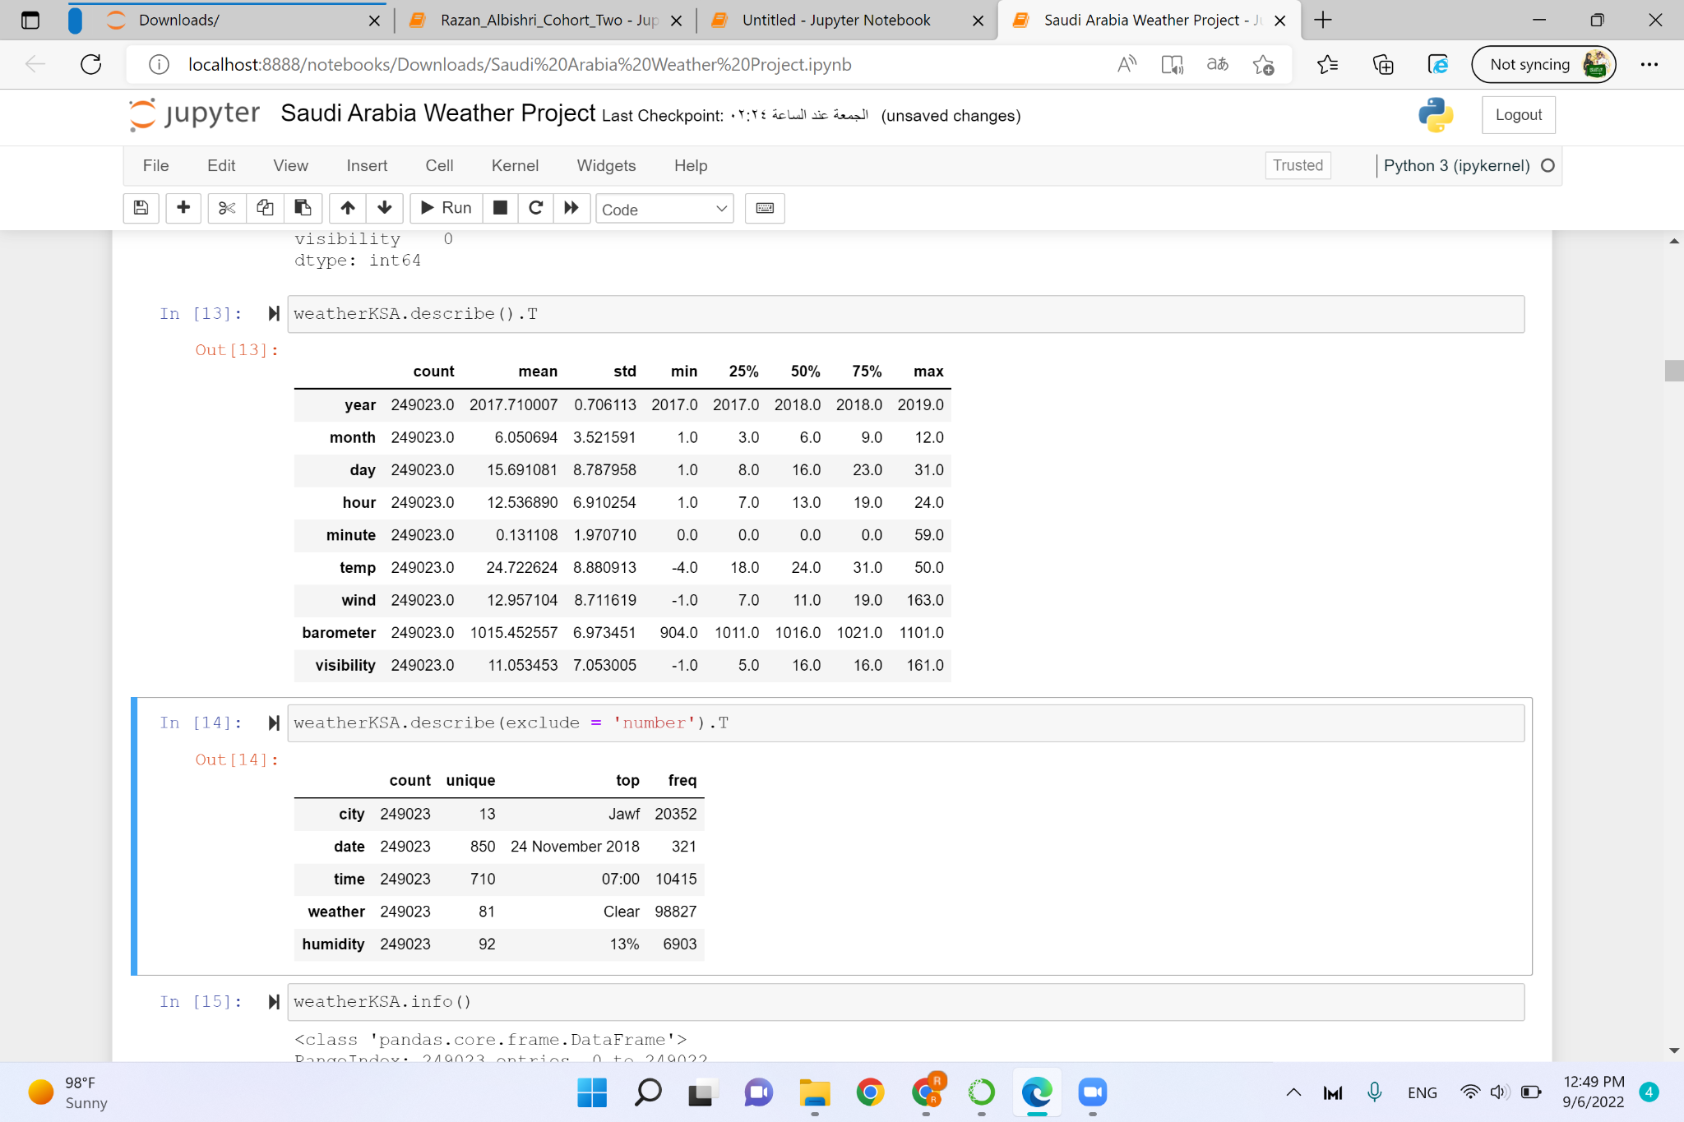
Description of Dataset

Slide 11
Description of Dataset

Slide 12
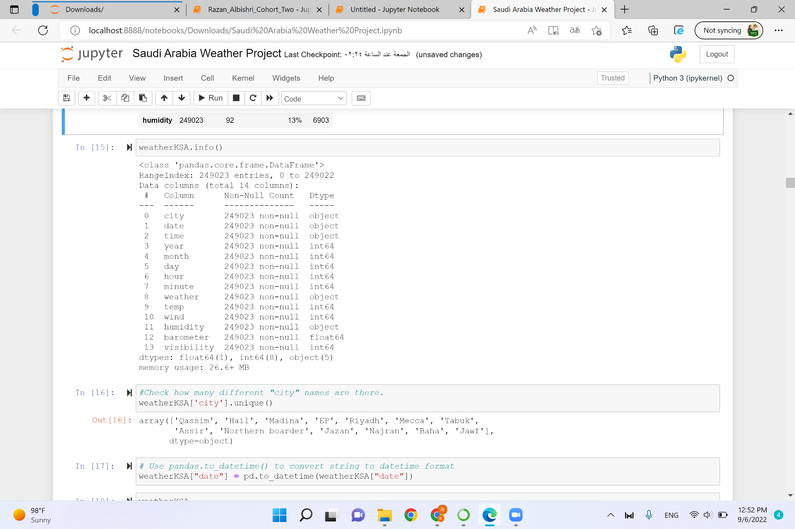
Dataset Information

Slide 13
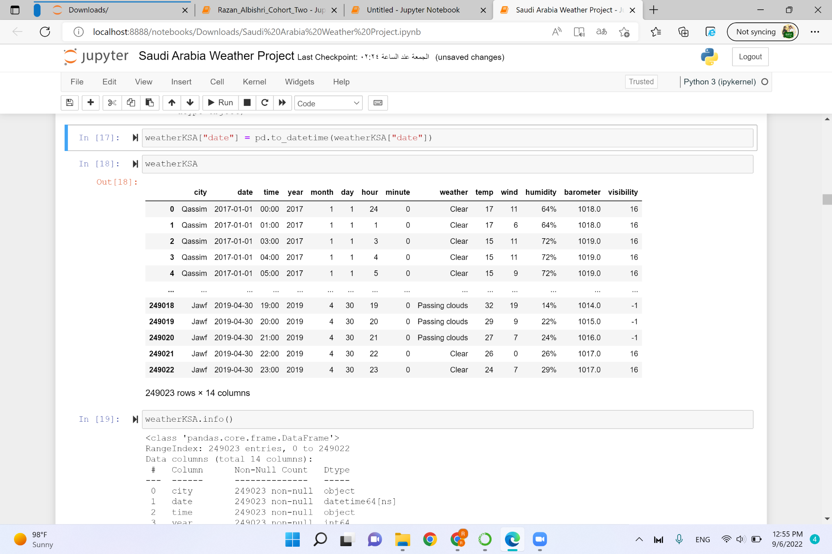
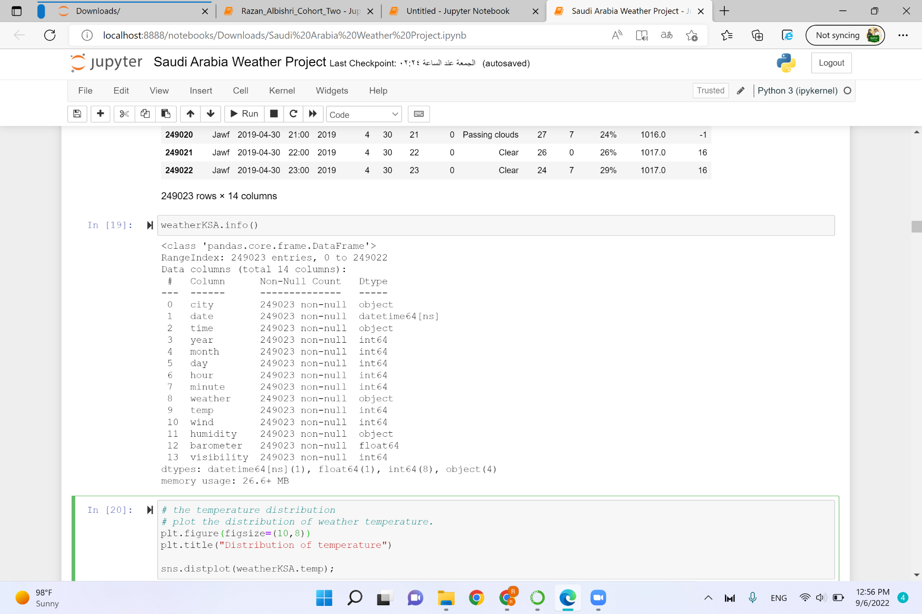

Slide 14
Performing EDA

Slide 15
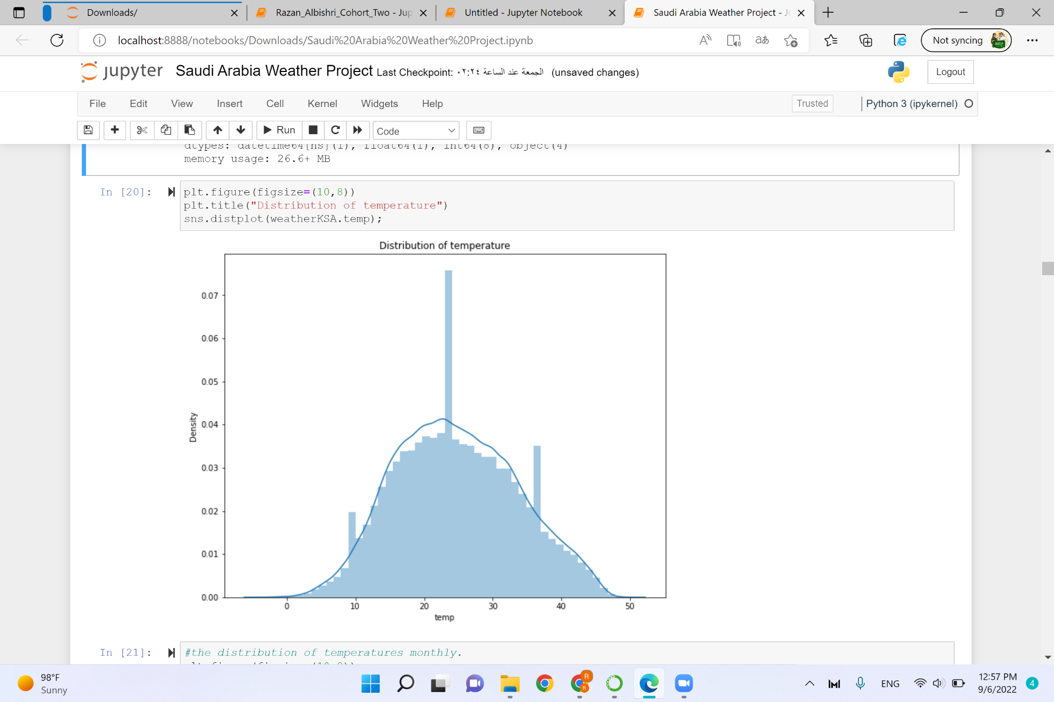
1st Plot

Slide 16
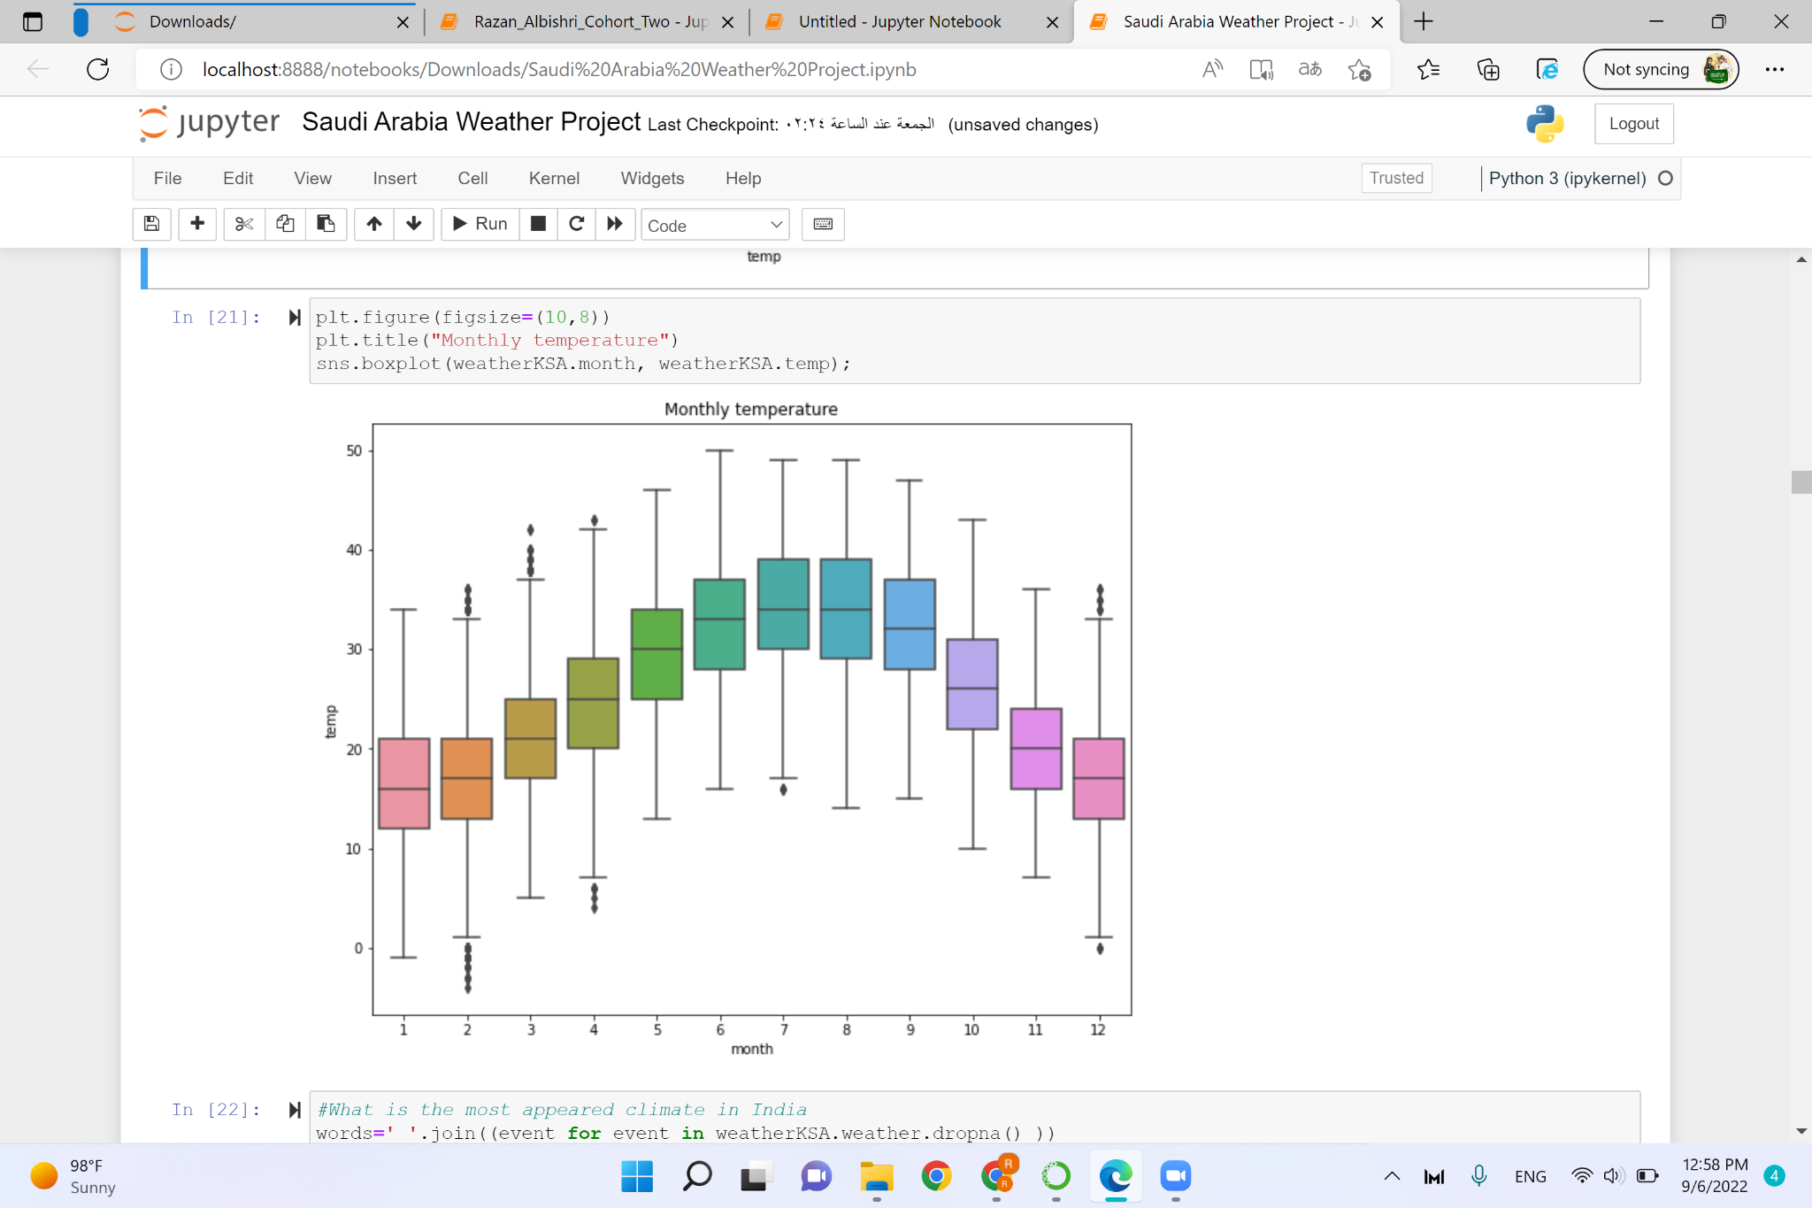
2nd Plot

Slide 17
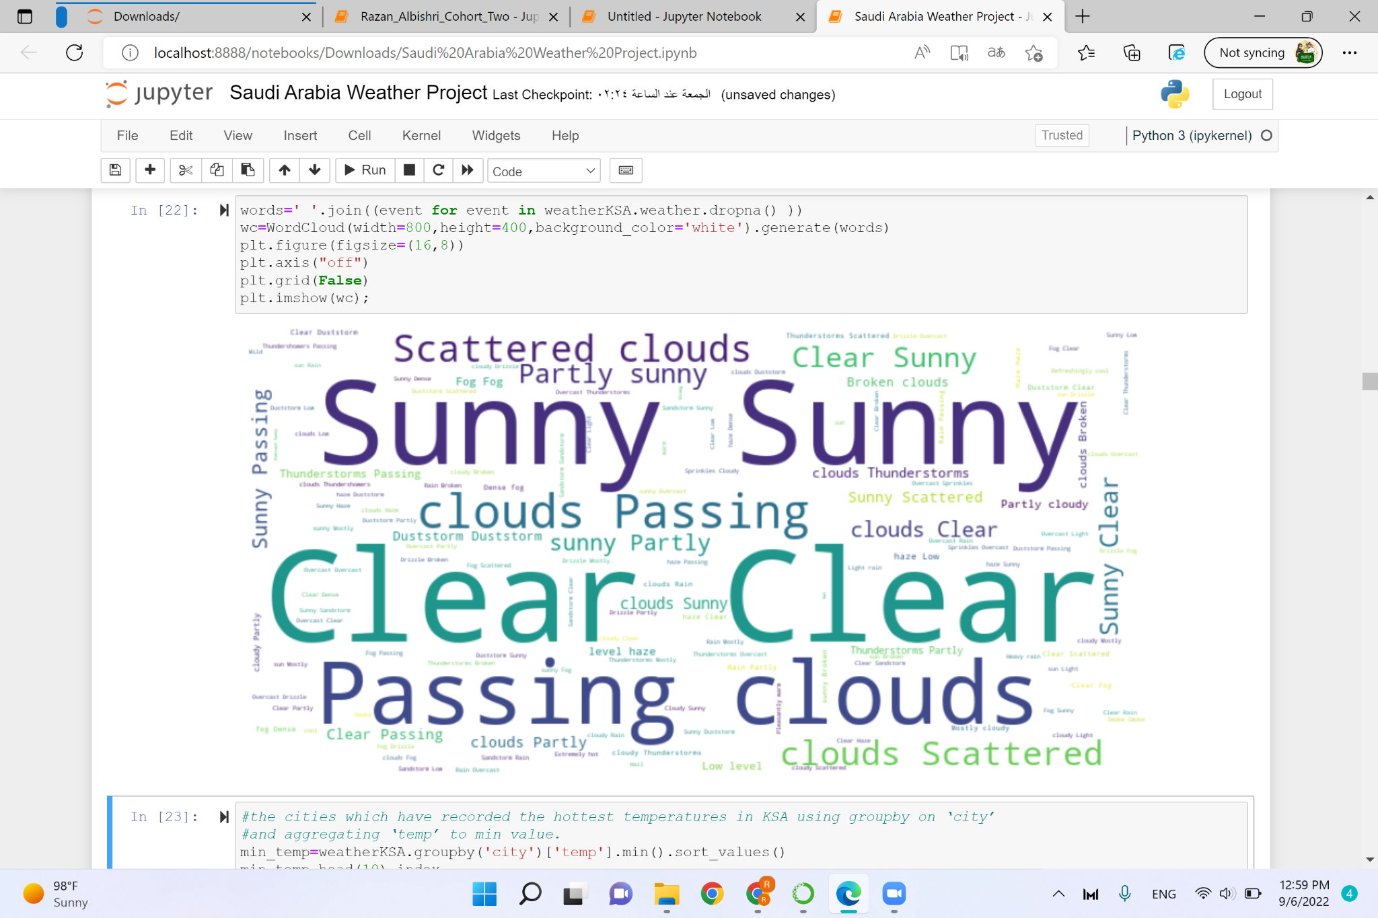
3rd Plot

Slide 18
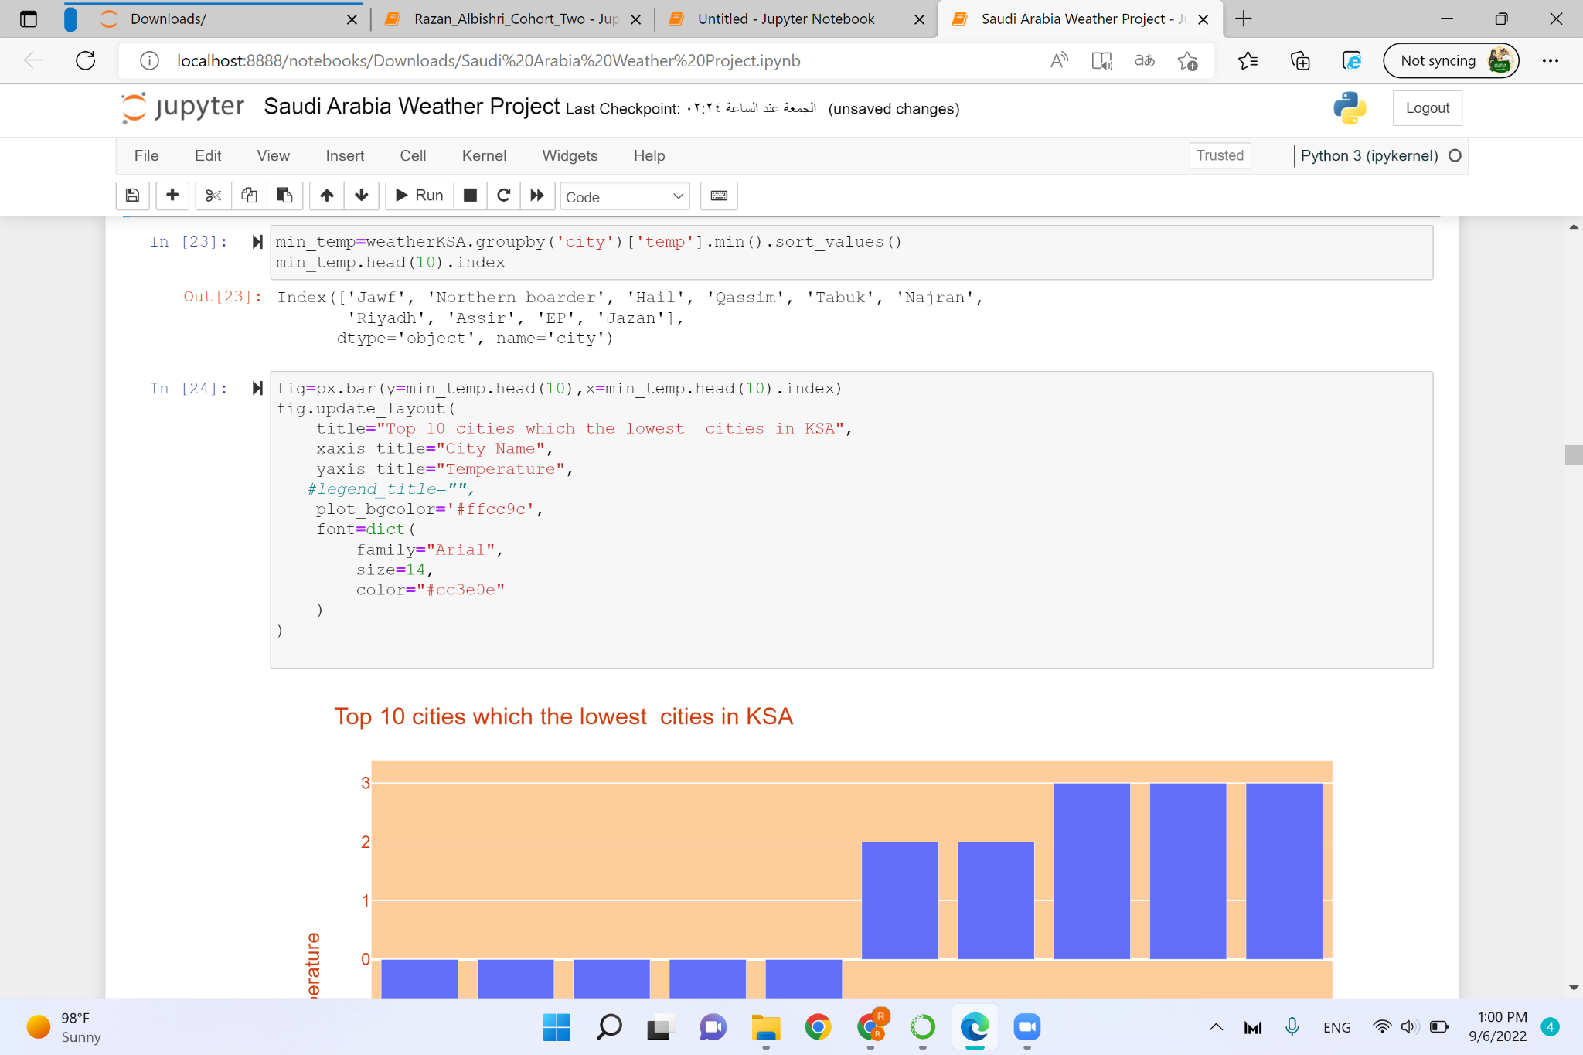
4th Plot

Slide 19
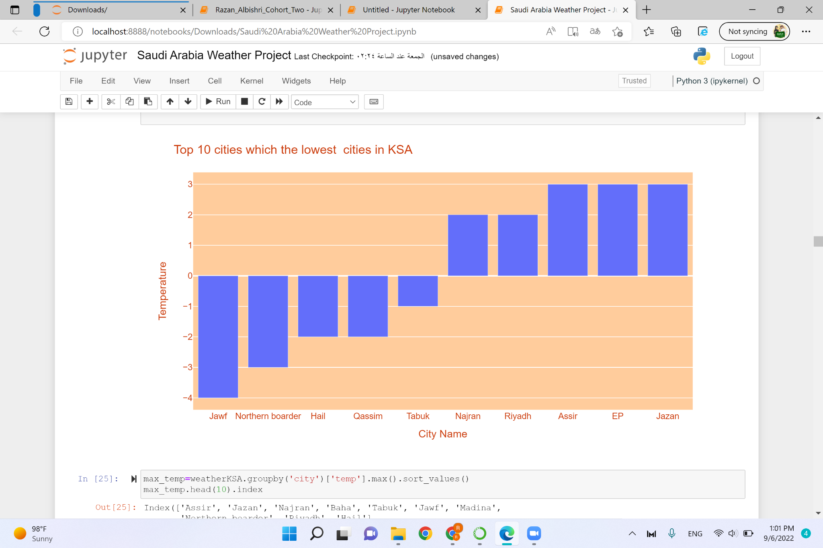
4th Plot

Slide 20
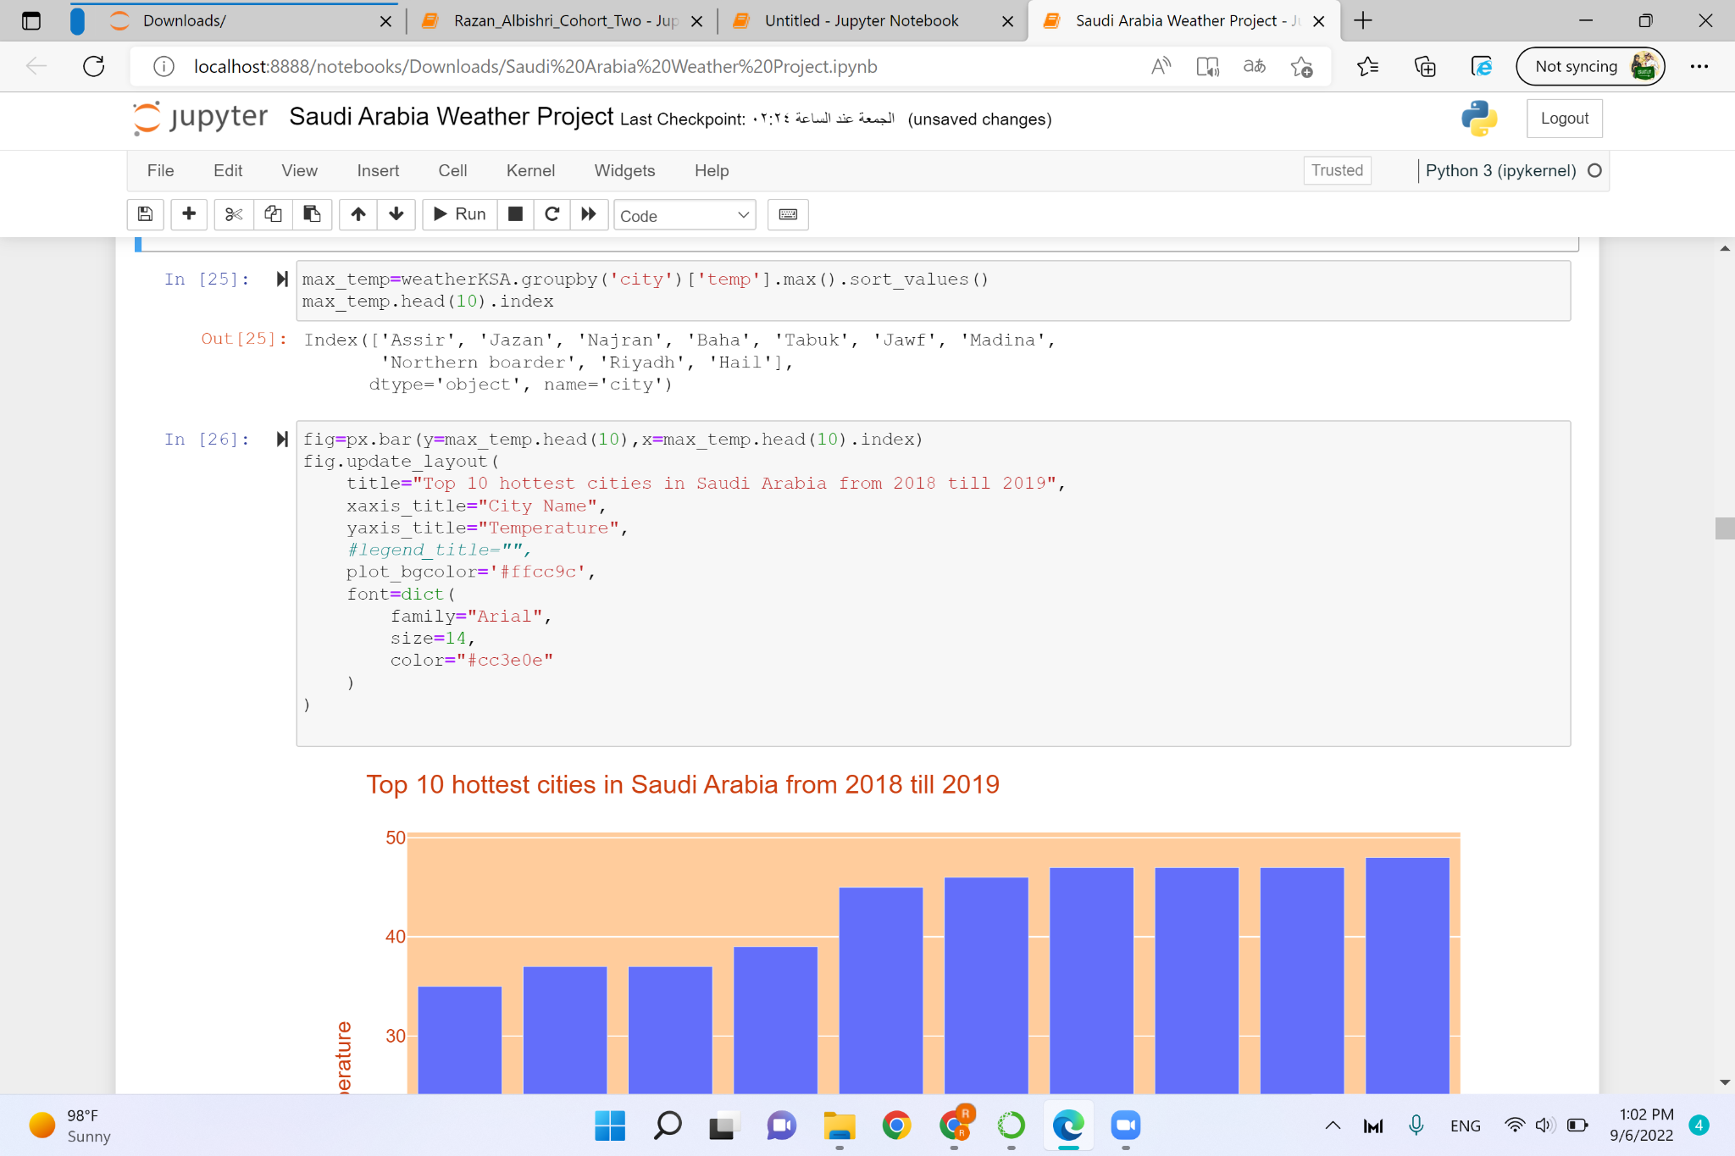
5th Plot

Slide 21
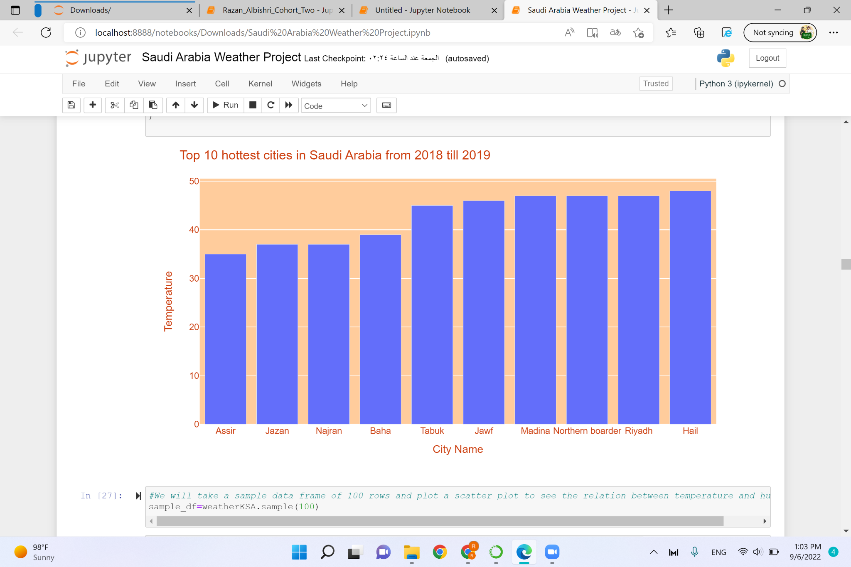
5th Plot

Slide 22
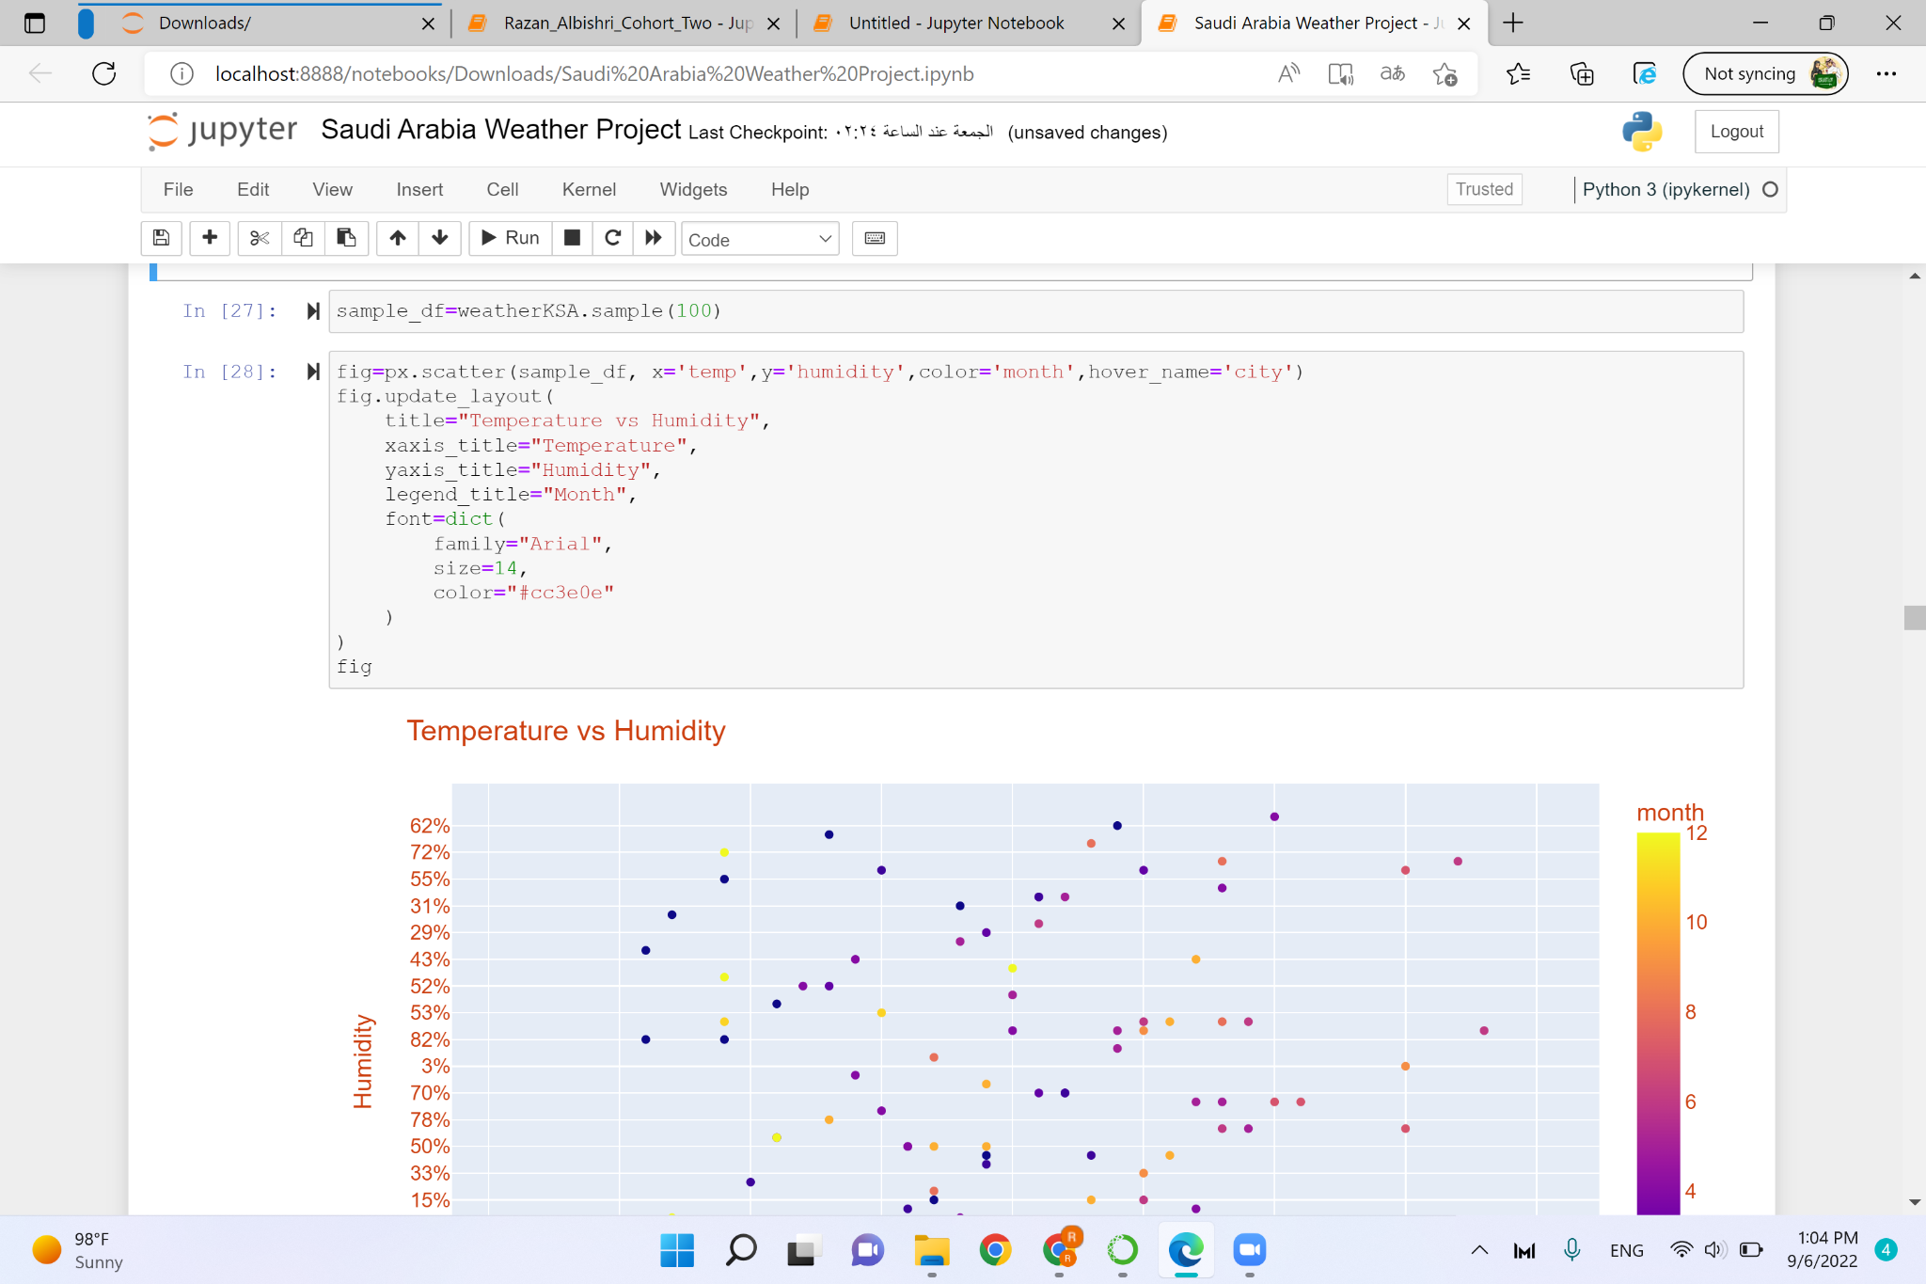
6th Plot

Slide 23
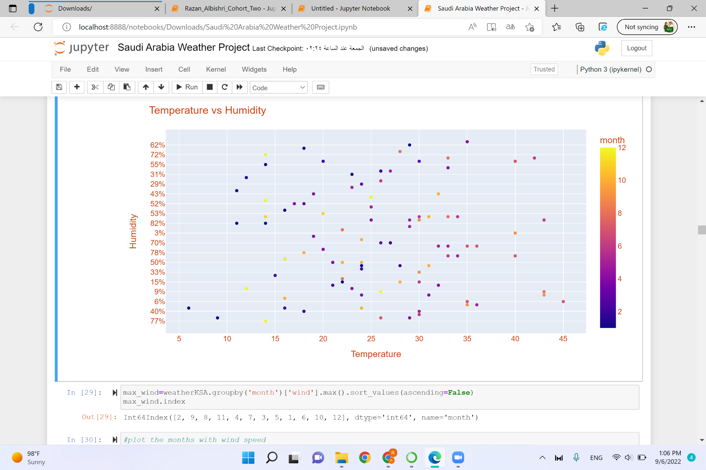
6th Plot

Slide 24
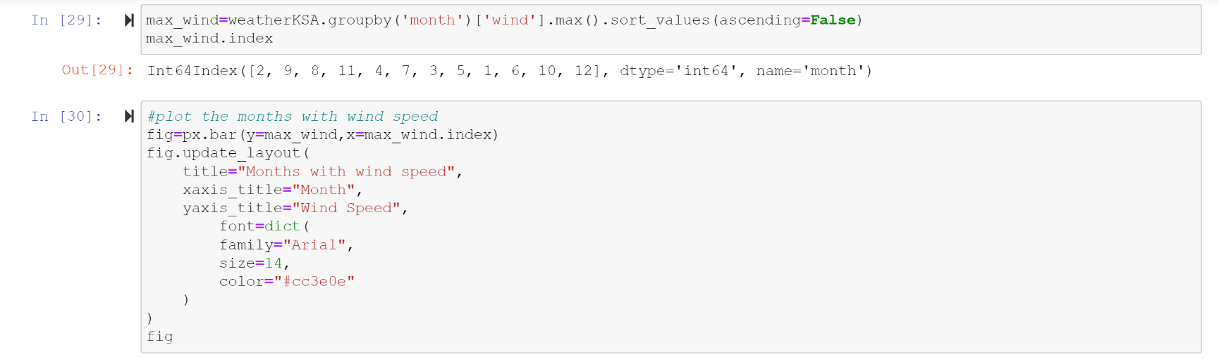
7th Plot

Slide 25
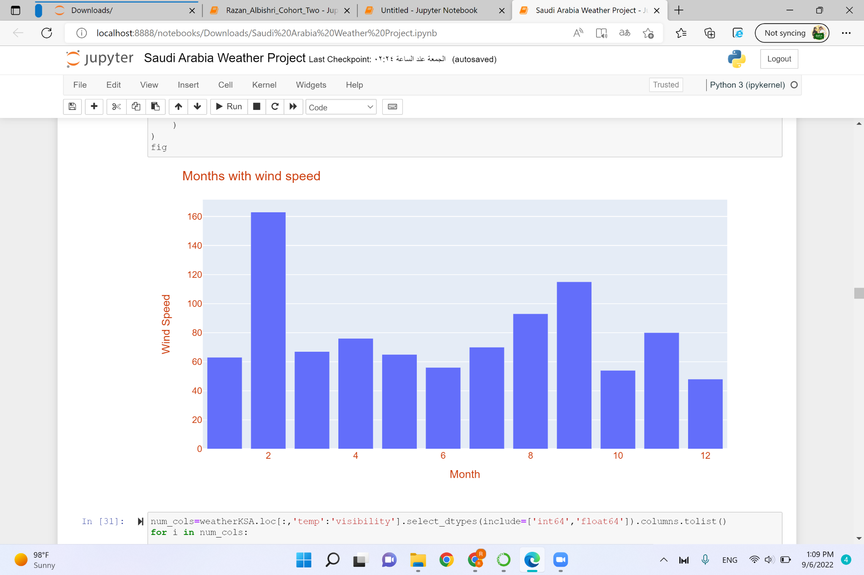
7th Plot

Slide 26
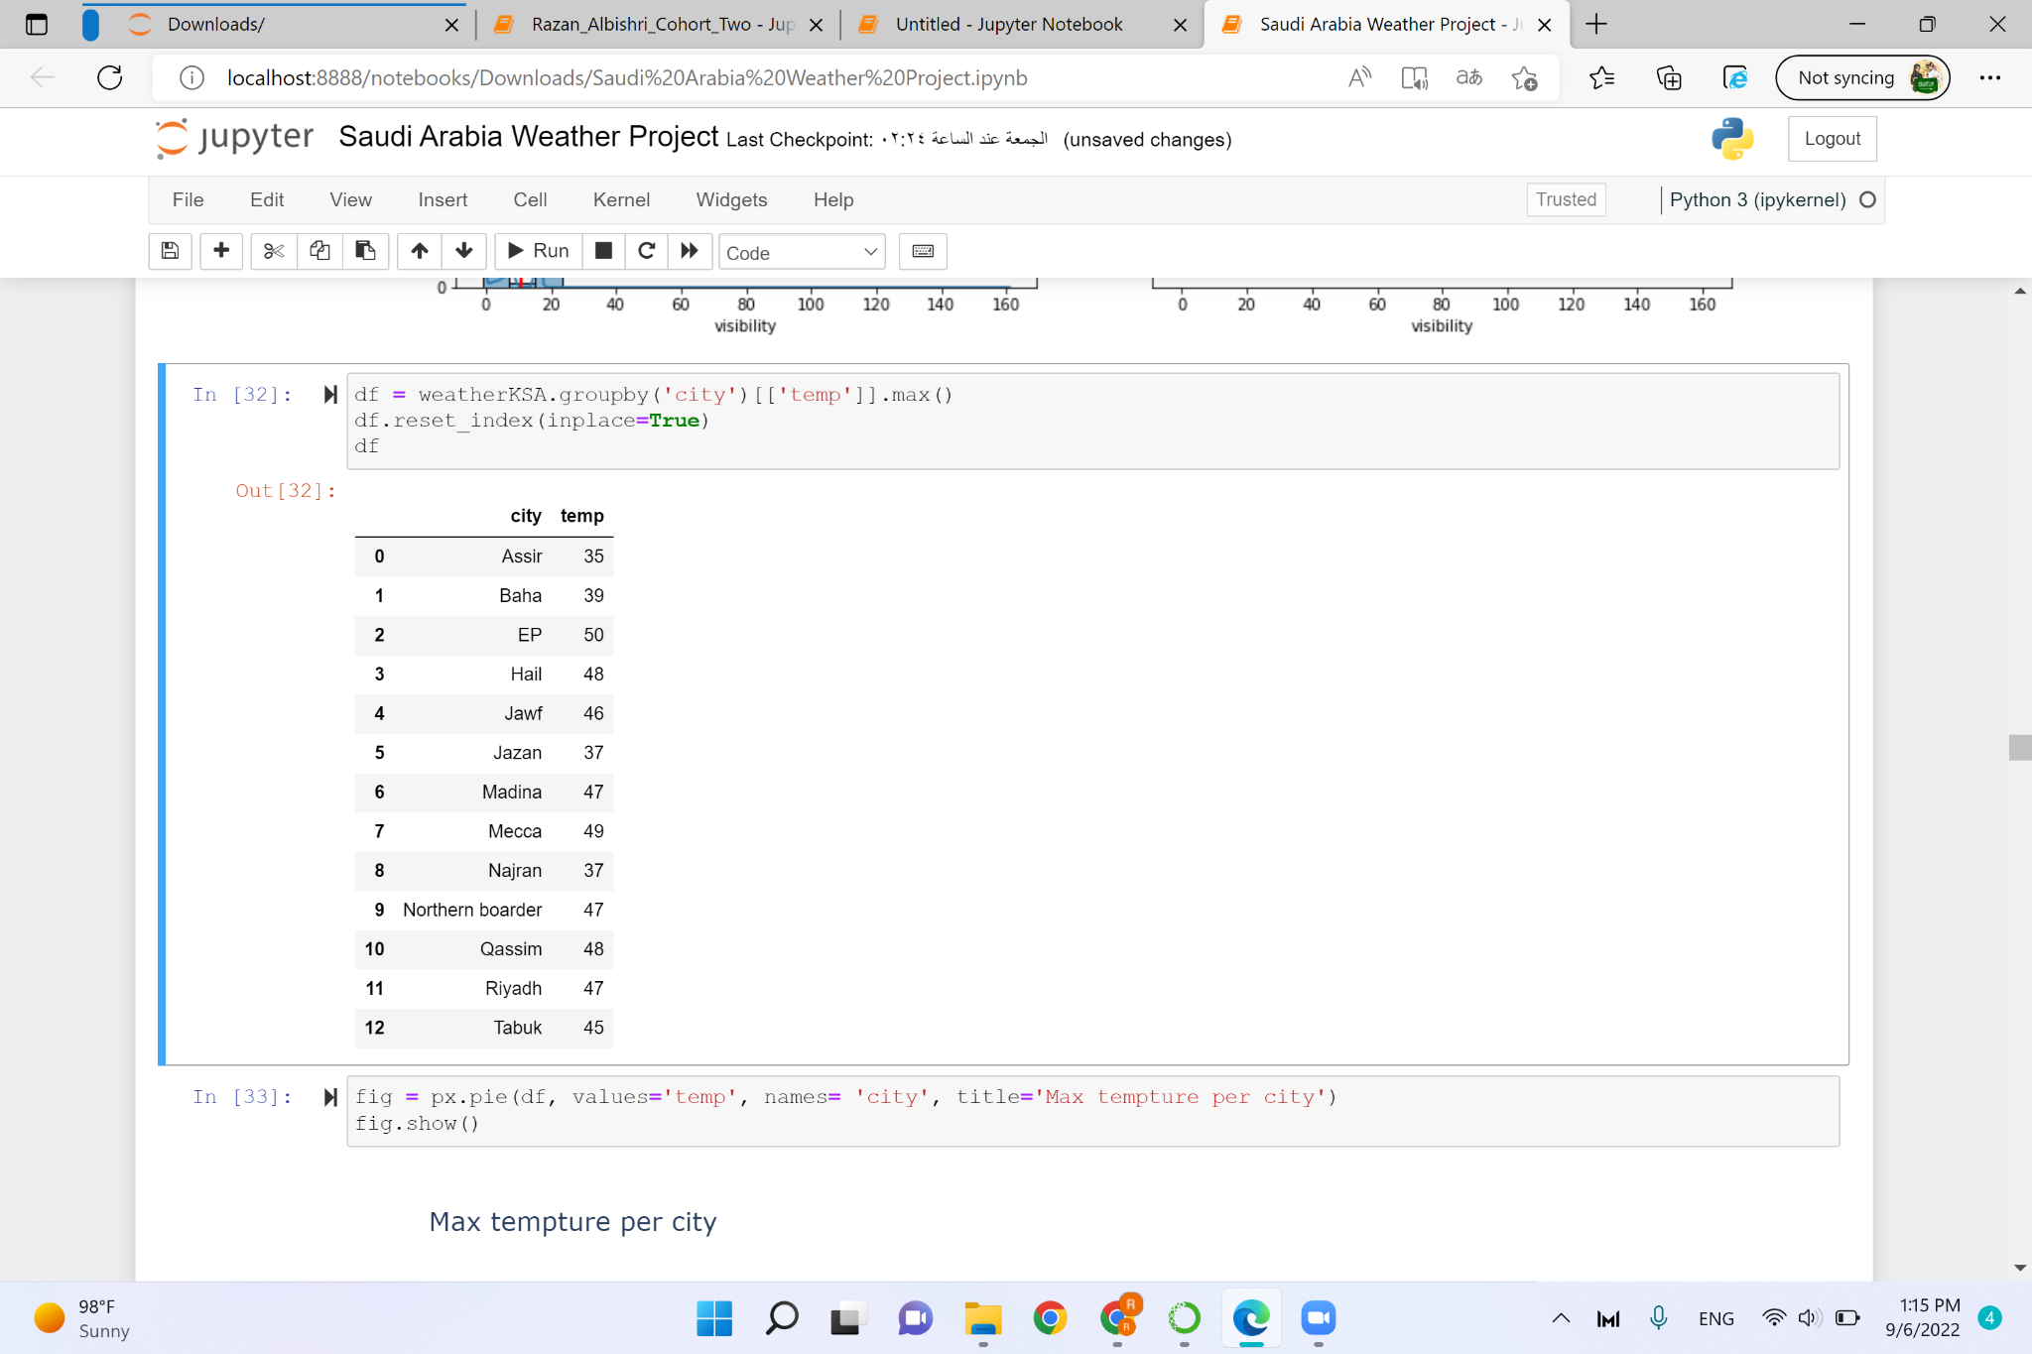
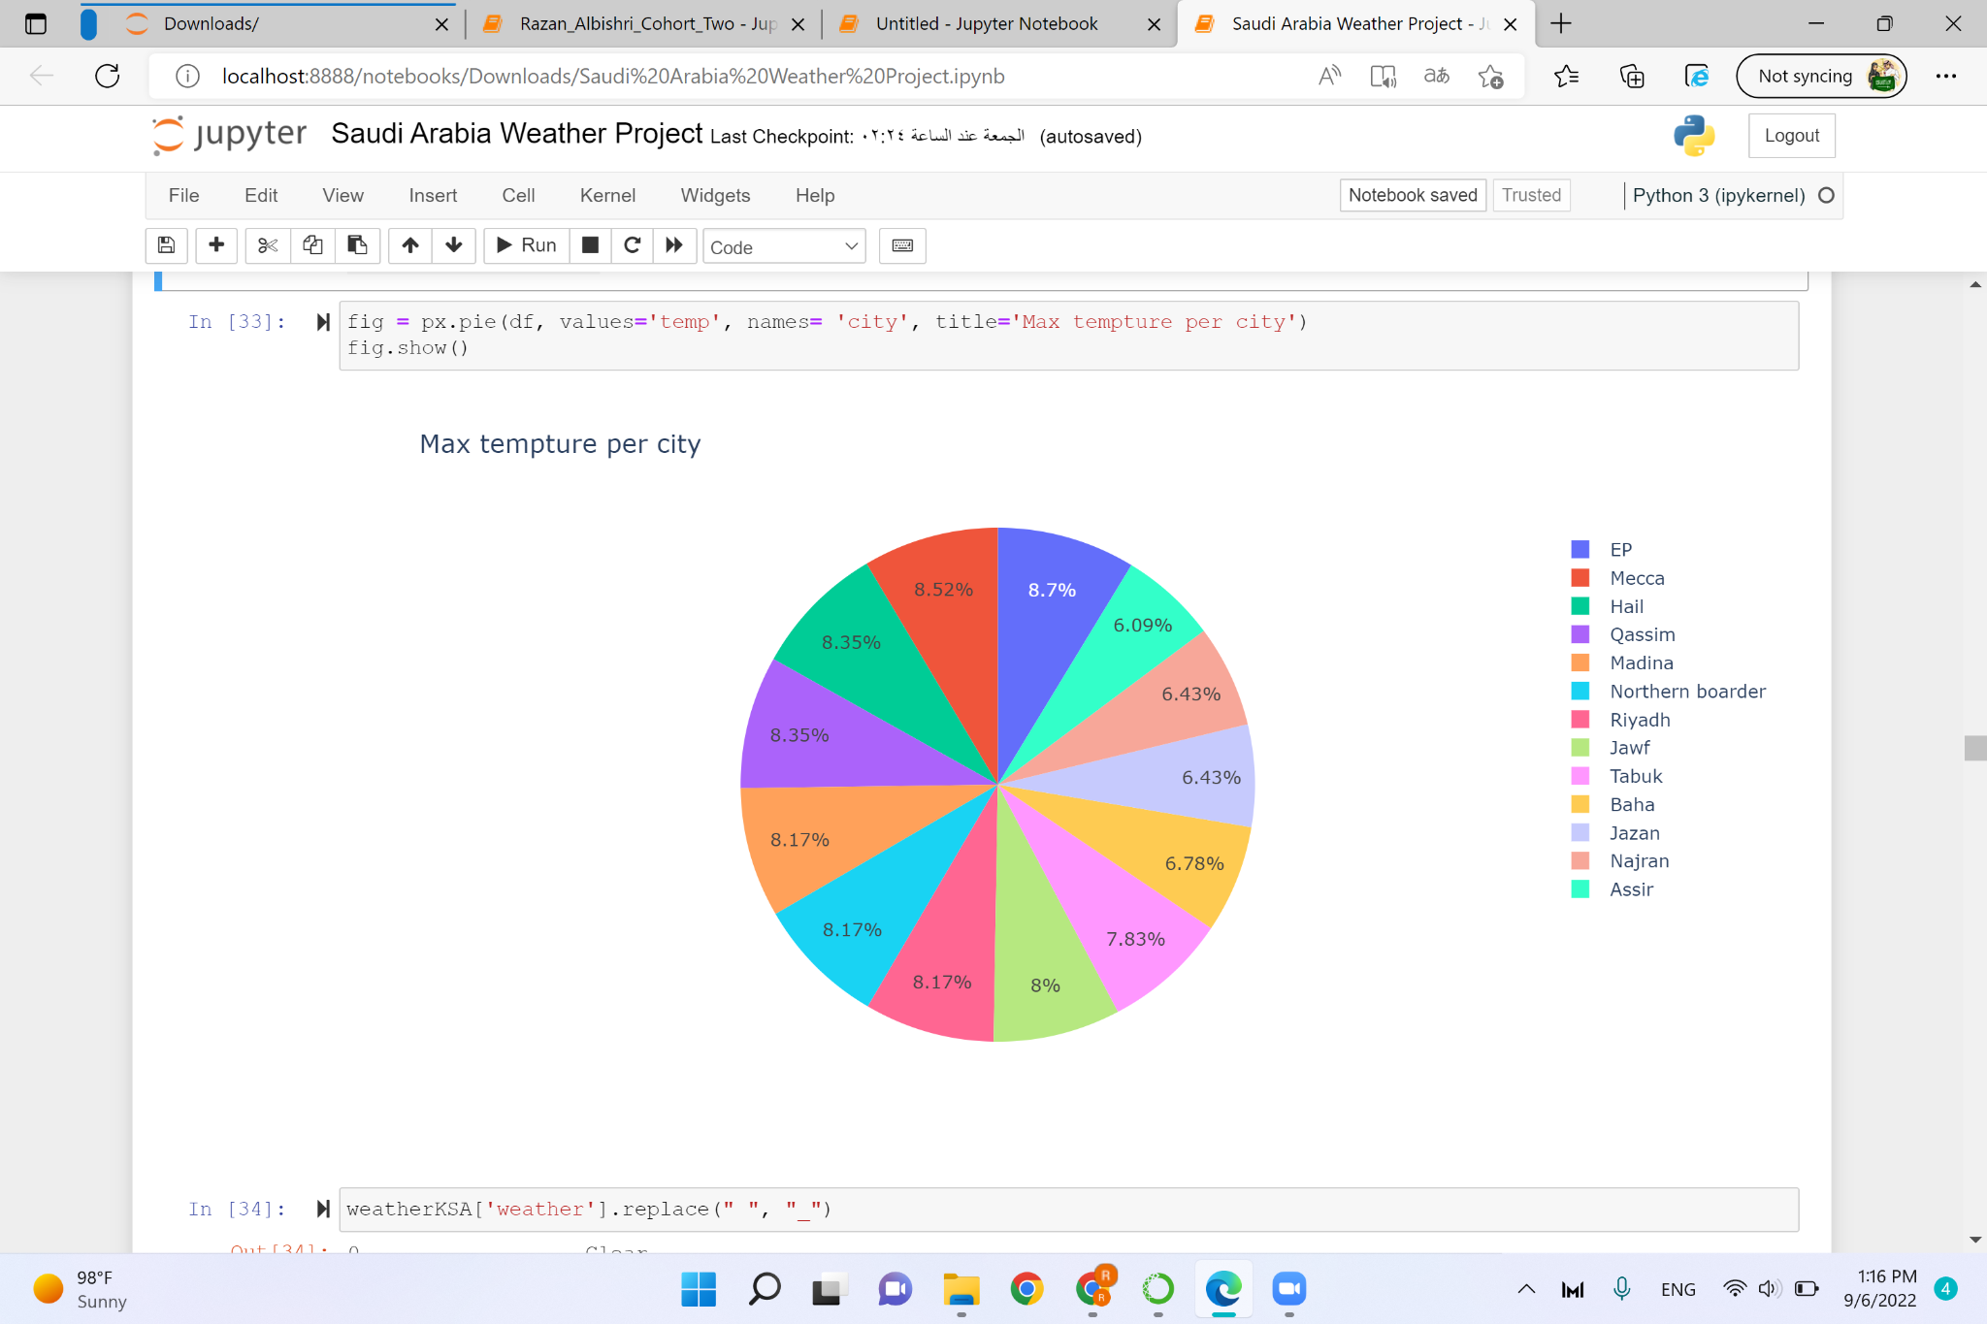
8th Plot

Slide 27
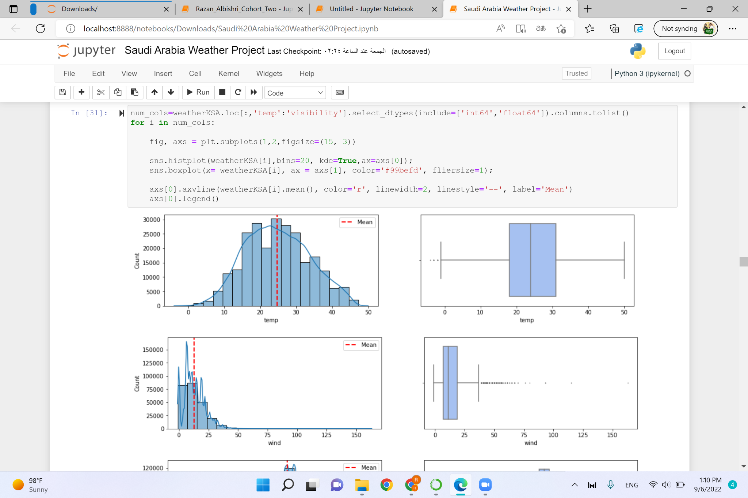
9th Plot

Slide 28
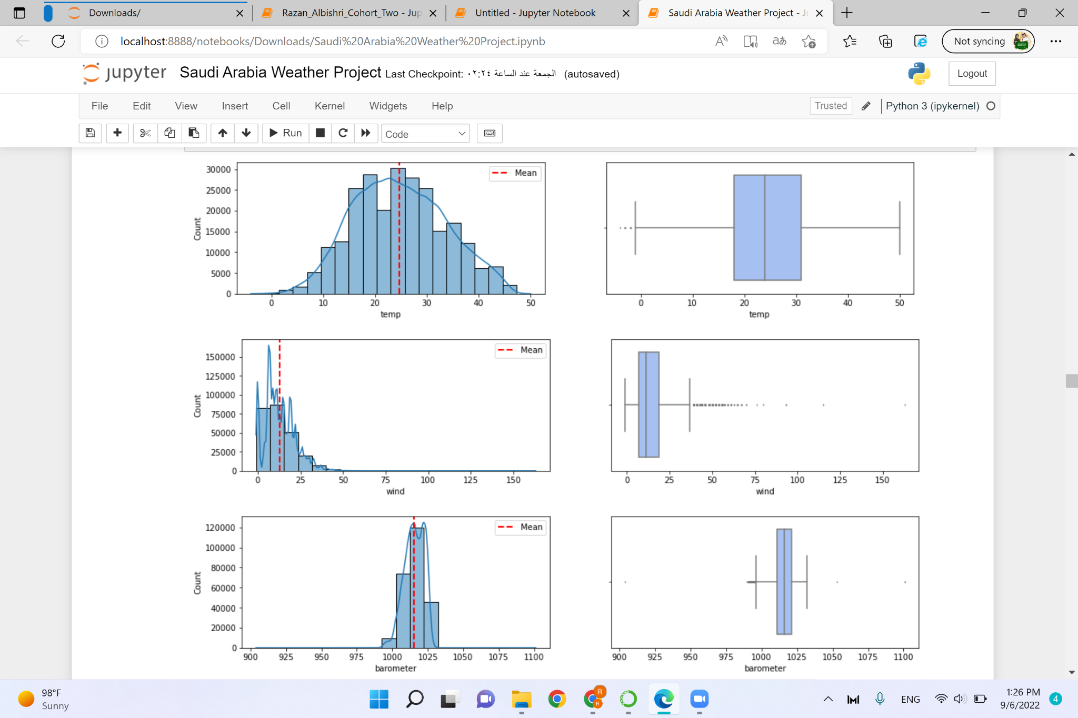
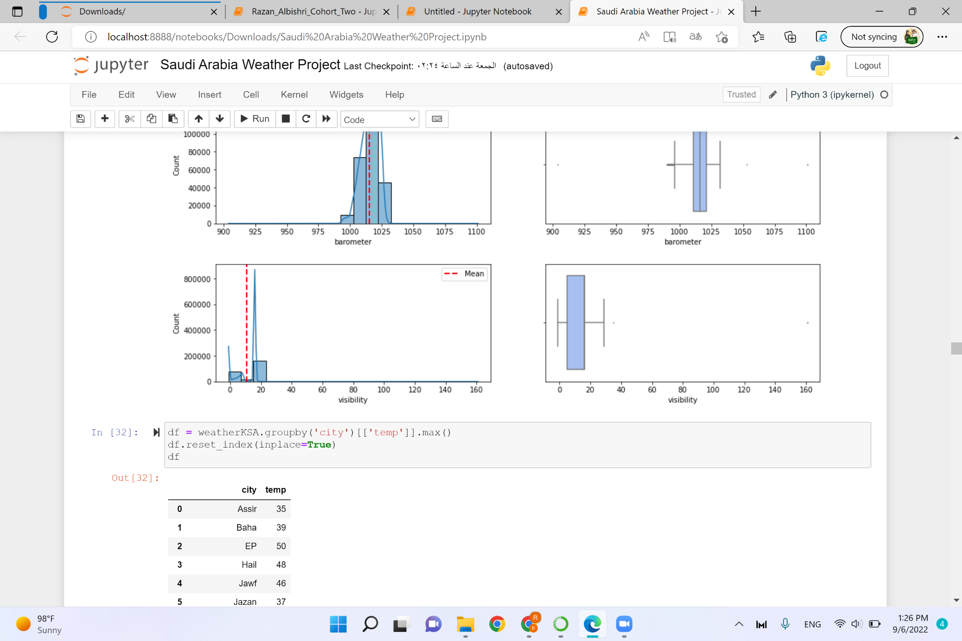

Slide 29
Machine Learning

Slide 31
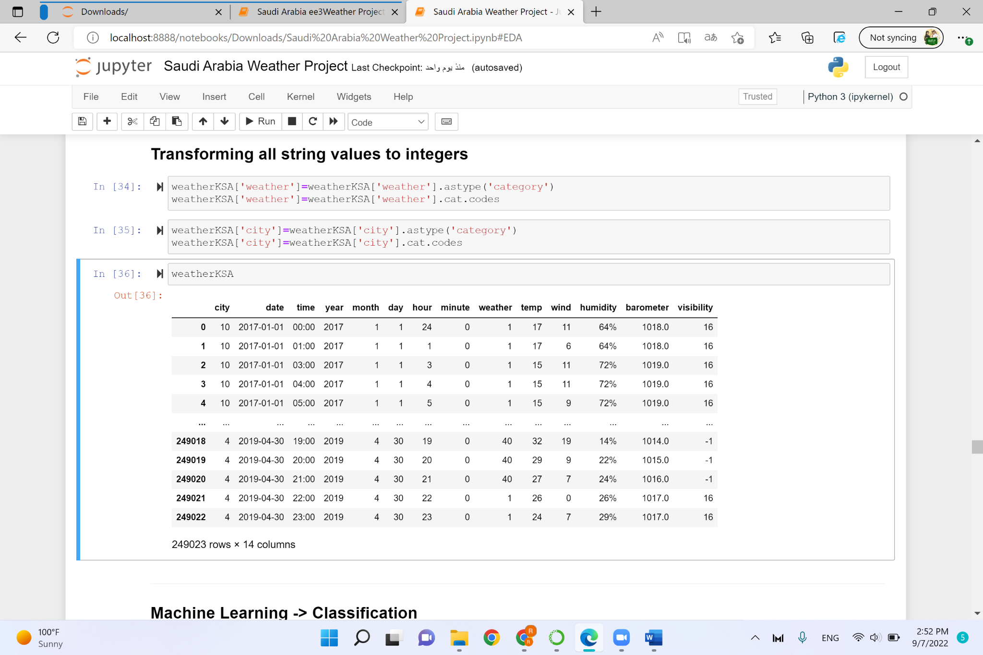
Transform all string values to integers

Slide 32
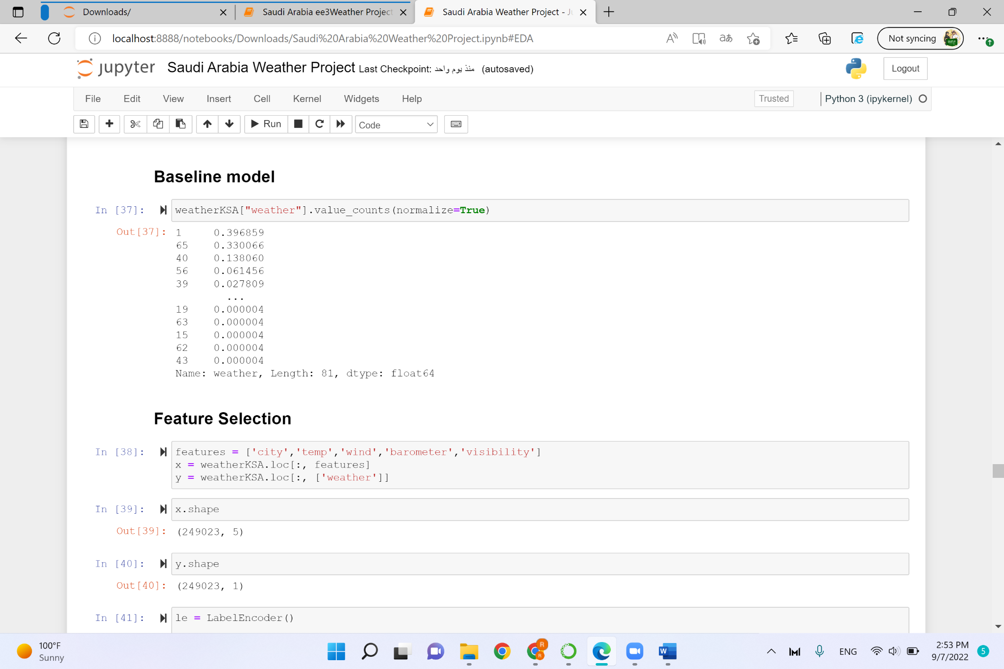
Baseline Model

Slide 33
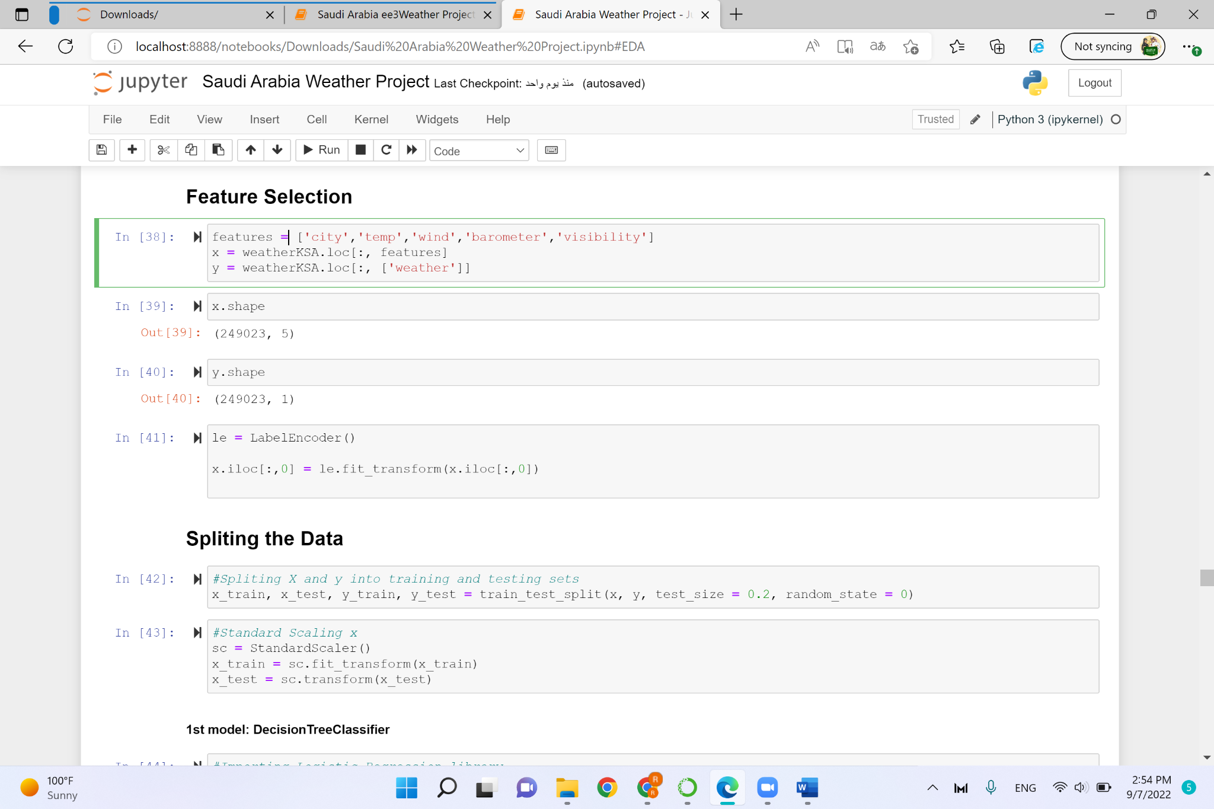
Feature Selection

Slide 34
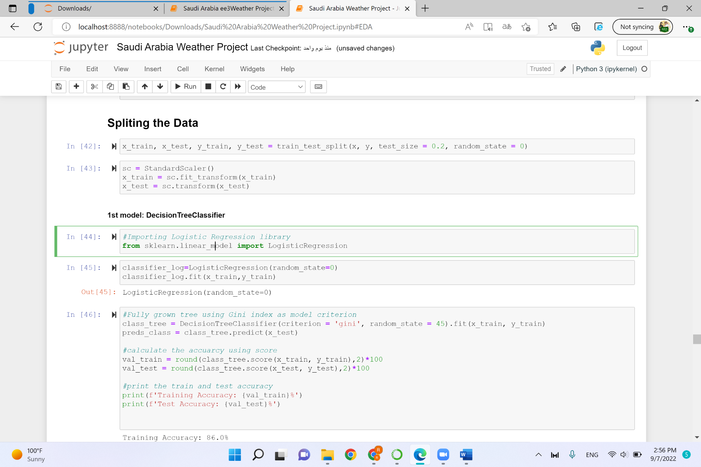
Split the Data

Slide 35
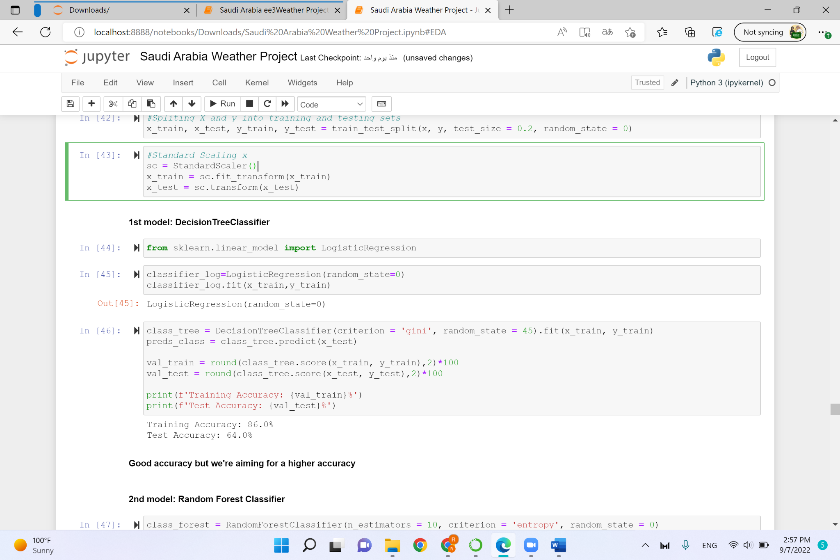
Machine Learning

Slide 36
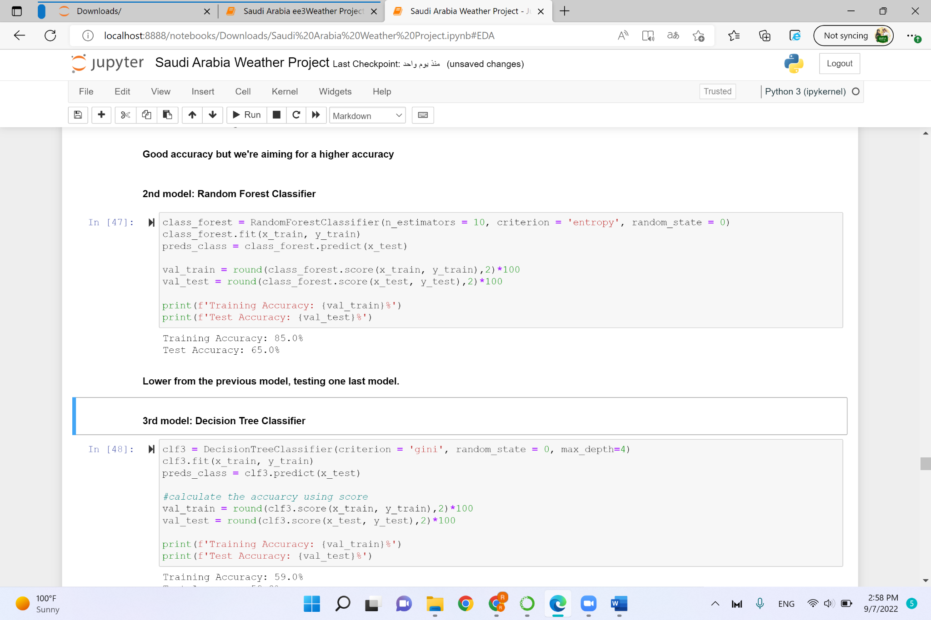
Machine Learning

Slide 37
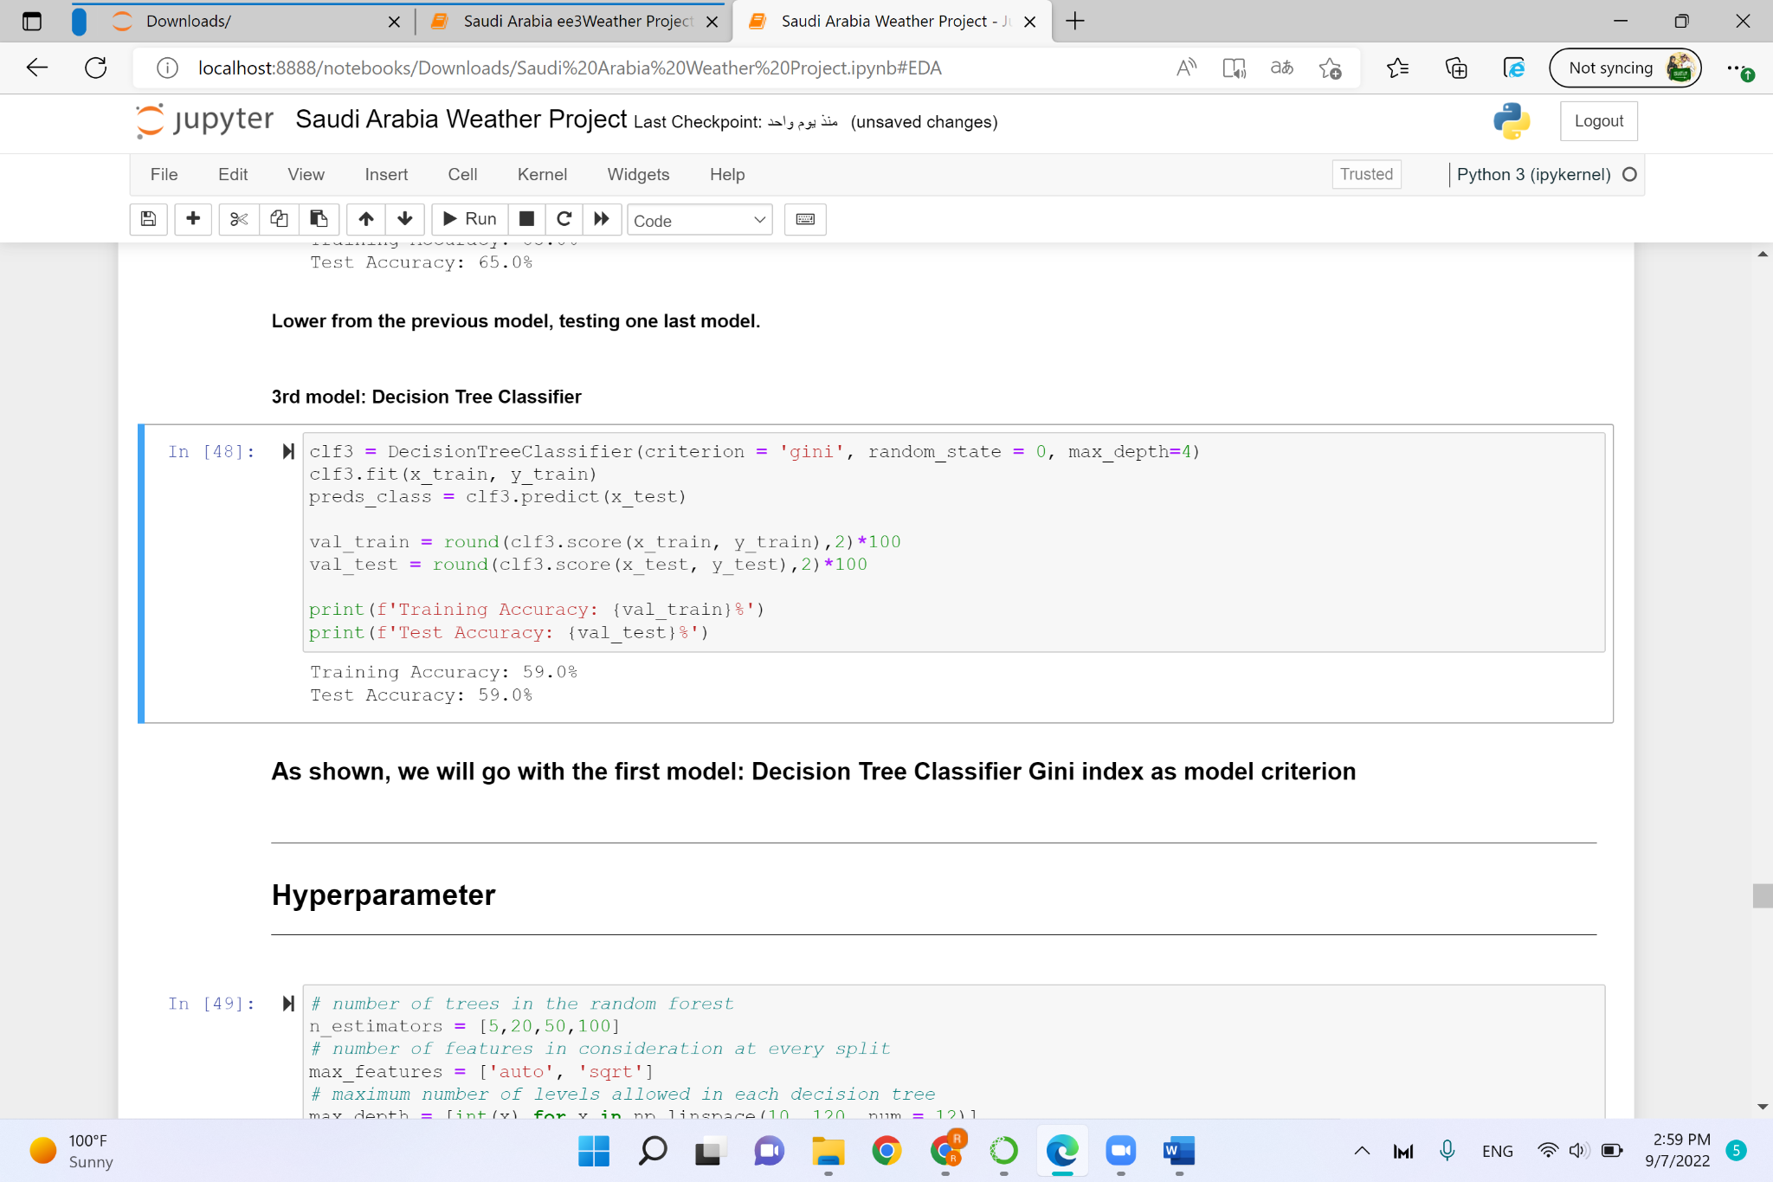
Machine Learning

Slide 38
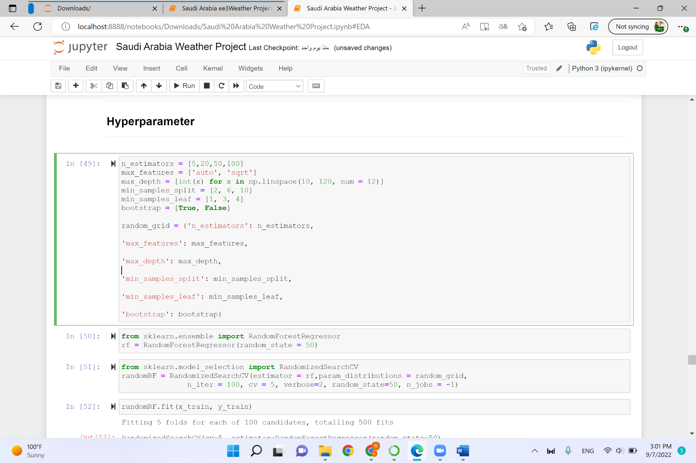
Hyperparameter

Slide 39
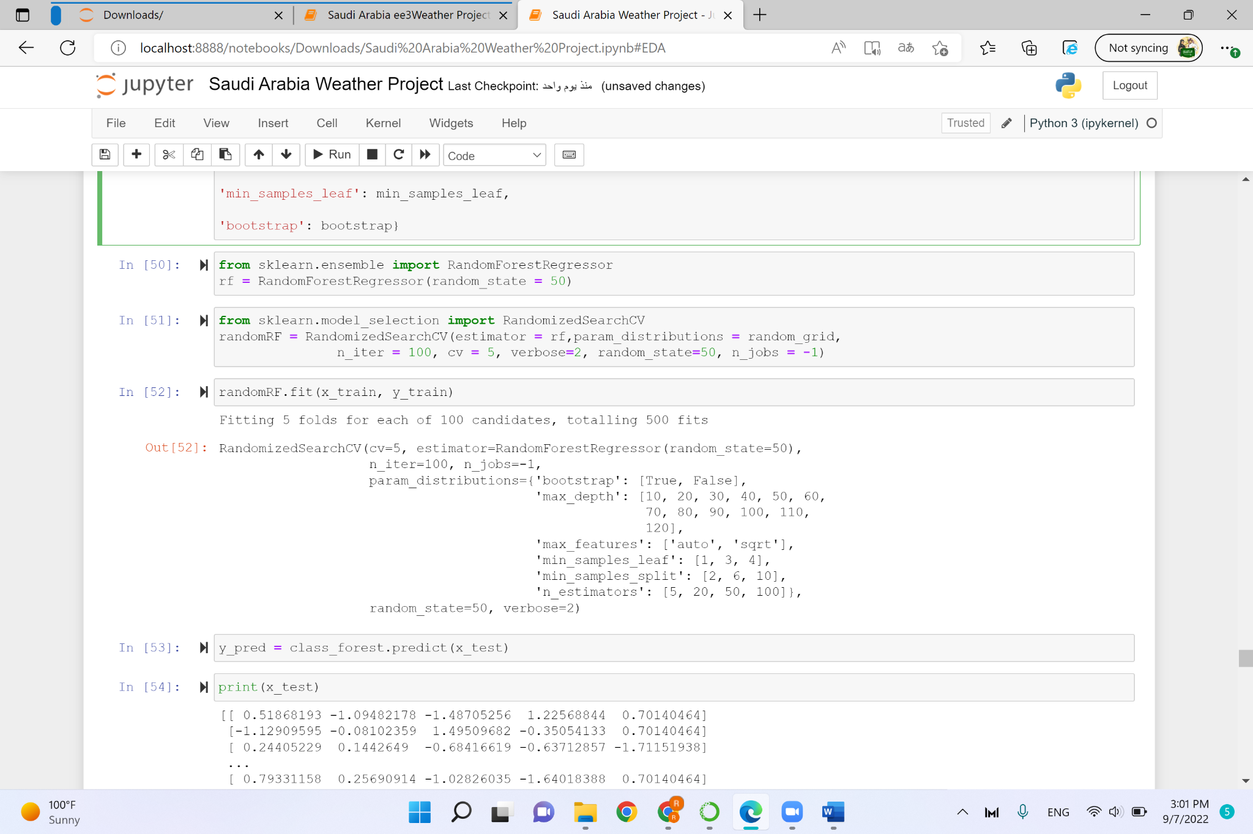
Hyperparameter

Slide 40
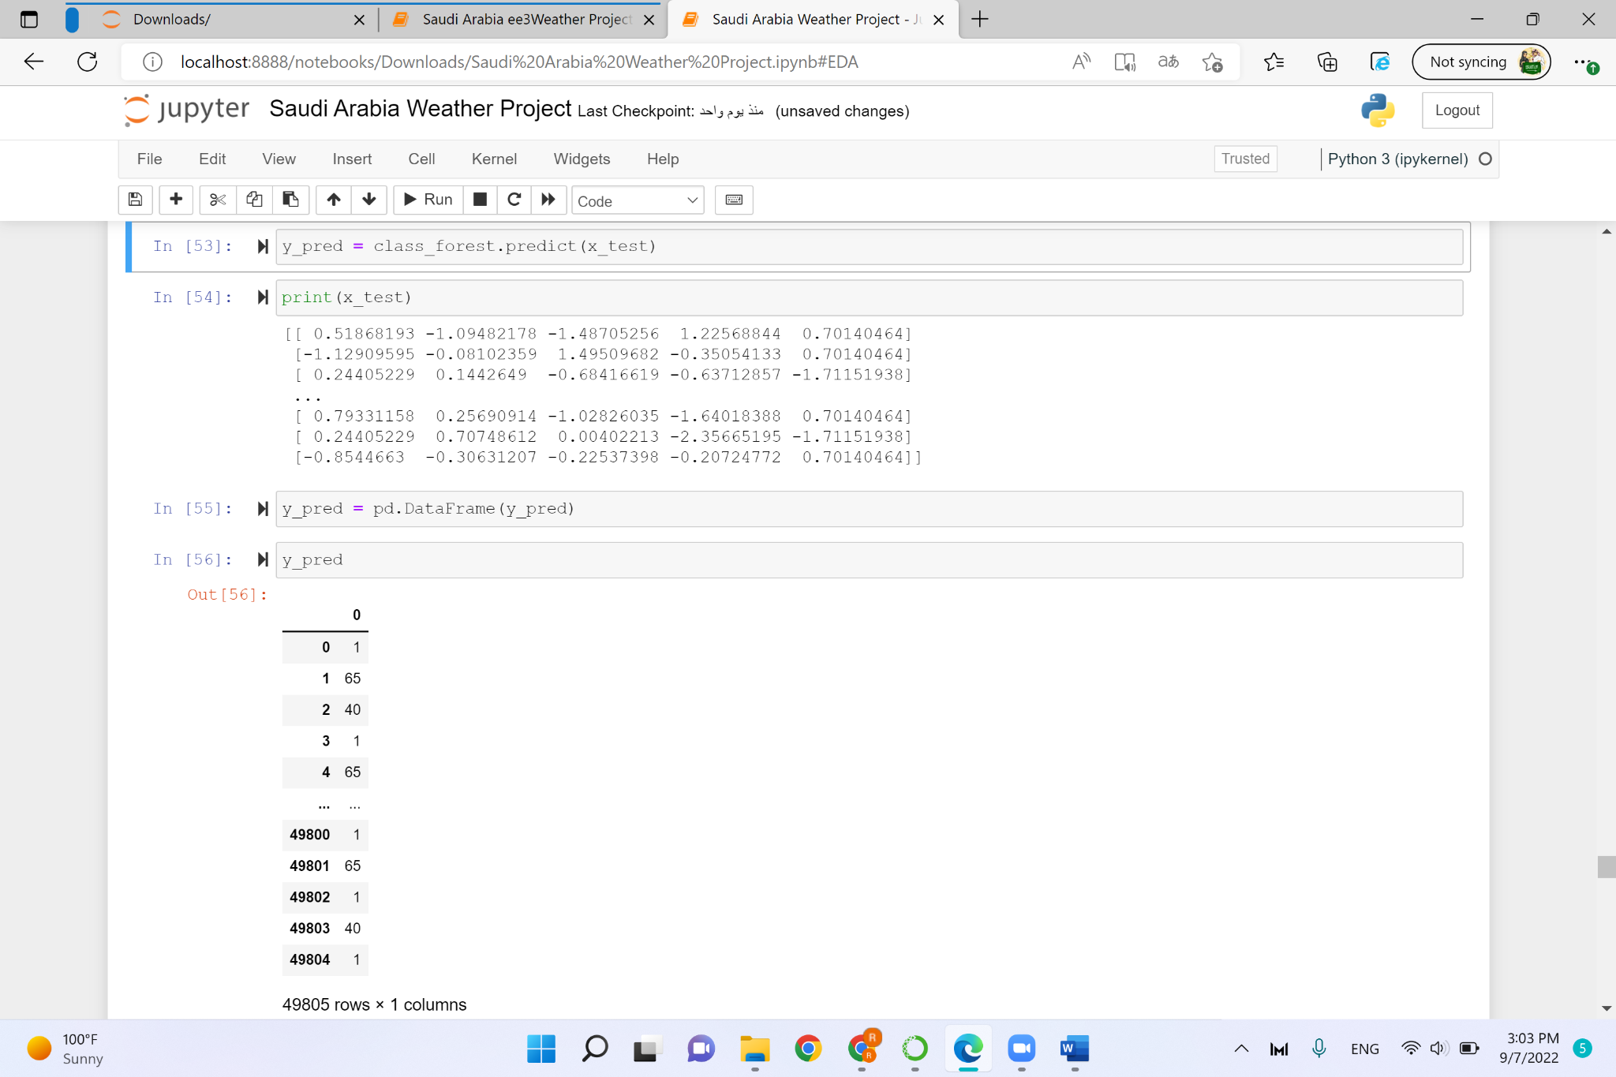
Hyperparameter

Slide 41
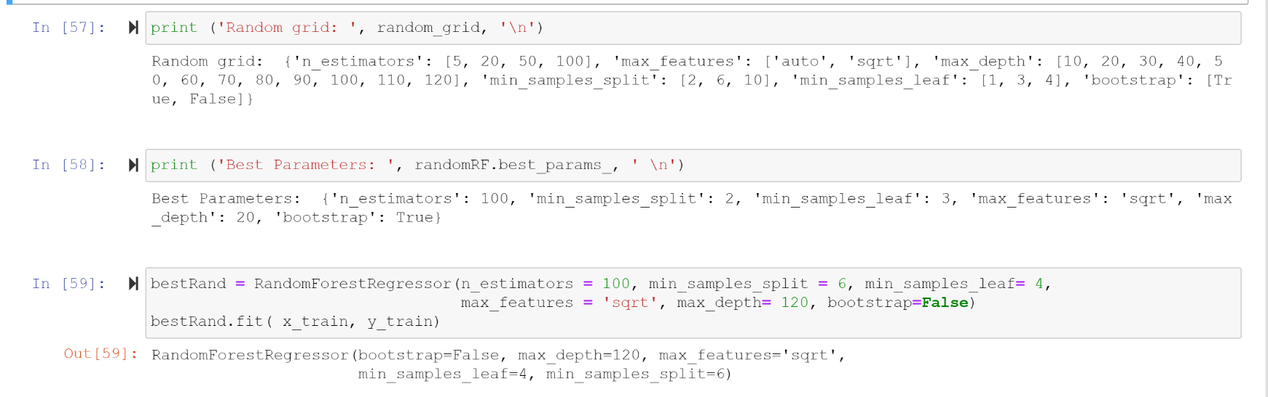
Hyperparameter

Slide 42
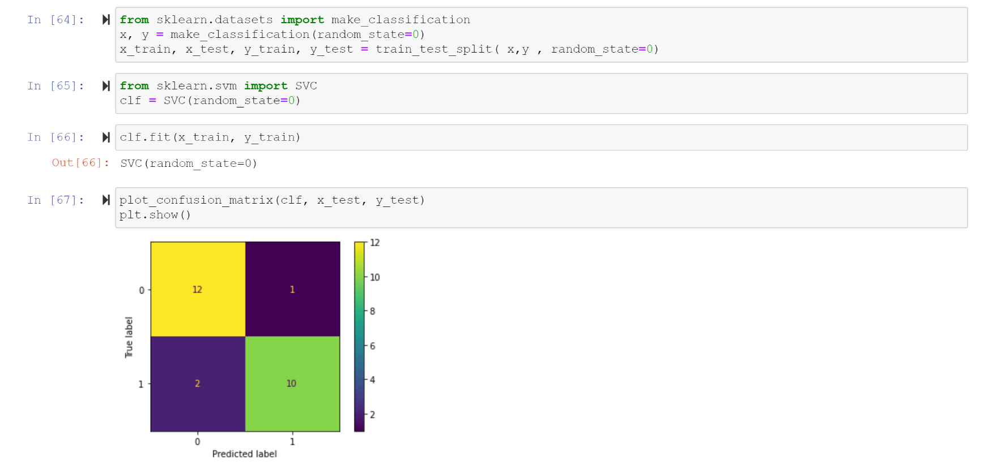
Model Evaluation

Slide 43
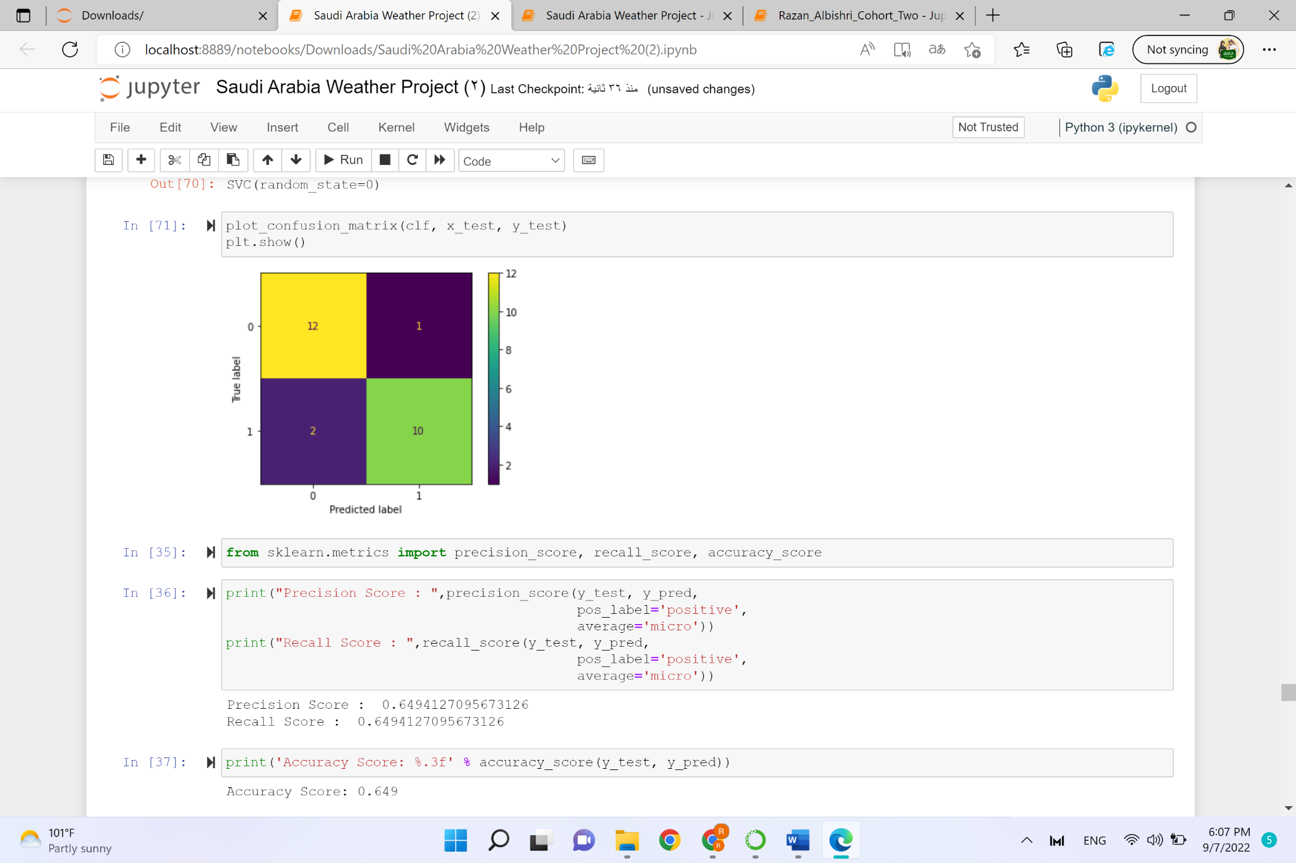
Model Evaluation

Slide 44
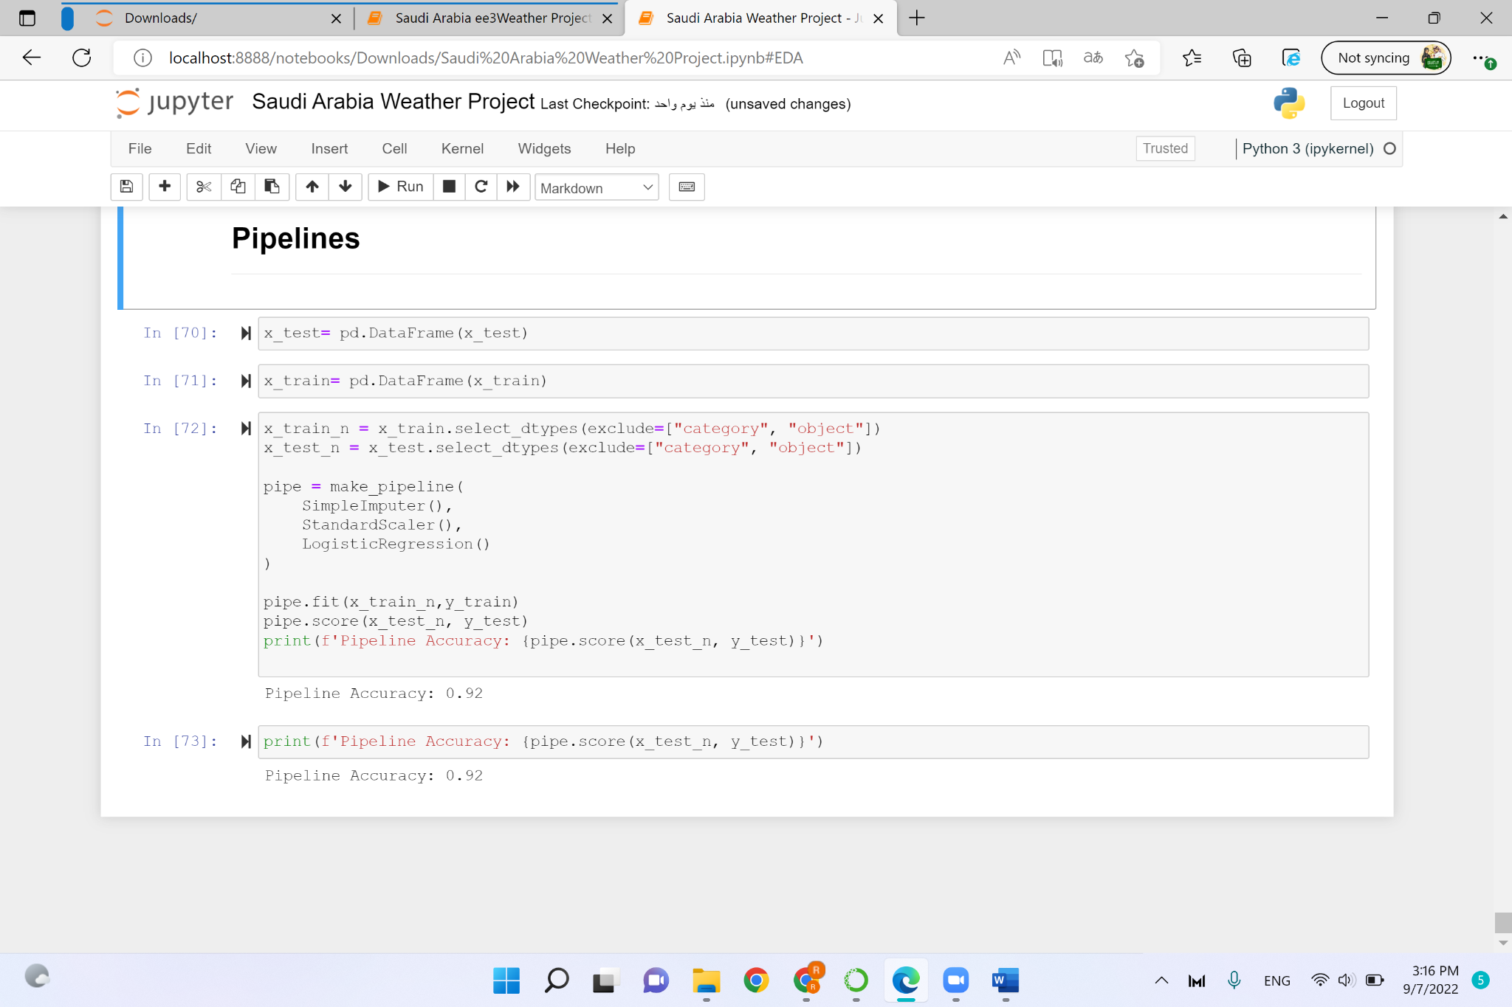
Pipeline

Slide 45
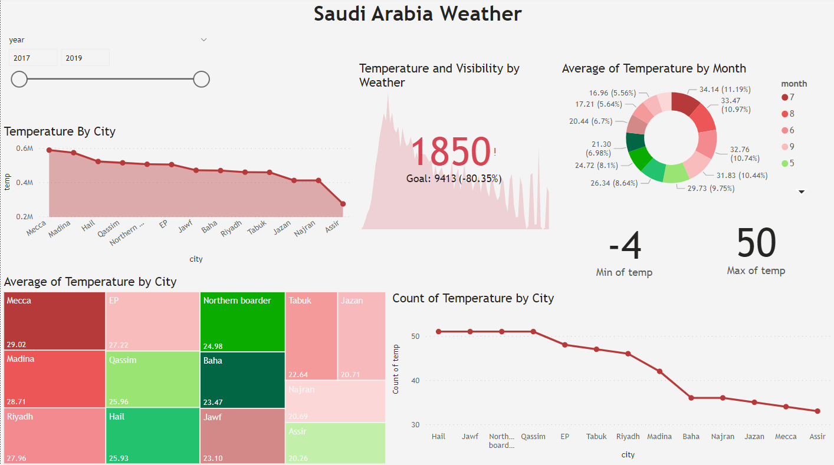
PowerBi Dashboard

Slide 46
Thanks

Slide 47
Resources
weather-sa dataset

